Slide 1



Fall 2026
Assessment Training
Division of Assessment and Accountability
September 9, 2026
MSDE, Pearson, Cambium Assessment
Notes:
MSDE – Good morning and welcome to the September 2026 MSTAR LAC Assessment Training. Today we will focus on the systems, roles, timelines, and operational steps LEAs need to prepare for the winter administration as a follow up from our last training in July.
The key points are Division of Assessment and Accountability; September 14-October XX, 2026; MSDE, Pearson, Cambium Assessment.
With that context, let us move to the next step in the process.

Slide 2
Introductions and Welcome
September Training Purpose Setting
Launchpad
TIDE
TDS
CRS
Customer Support and MSTAR Portal
Looking ahead!
Notes:
Pearson - Today's presentation will cover an introduction to the new MSTAR program and will further introduce you to the online systems that will be part of the test registration and administration beginning in SY26-27.

Slide 3
Welcome to the 2026 September LAC Training!
Notes:
MSDE/ Brianna Pearson - Welcome, we are glad to have you here!

Slide 4

Transition to
Introduction
2026-2027
New MSTAR Blueprint:
ELA 3-8
Math 3-8
Legacy MCAP:
ELA/math HS
Science
Social Studies
2027-2028
New MSTAR Blueprints
ELA
Math
Science
Social Studies
Notes:
Brianna - The new MSTAR testing program is transitioning over the next two years. This slide describes the timeline for the new blueprint and short, multi-stage adaptive test design. ELA and Mathematics, grades 3-8 will transition first in Spring 2027 with the rest of the assessments transitioning in Spring 2028.

Slide 5
Agenda, Day 1
MSTAR Fall 2026 LEA Trainings | Time | Presenter
Welcome, Introduction and Agenda | 9:00-9:10 AM | MSDE/Pearson
Winter 2026 Administration and Milestones | 9:20-9:30 AM | Pearson
Launchpad and User Roles | 9:30-10:15 AM | Pearson, CAI
TIDE and TDS - Preparing for Testing | 9:30-10:15 AM | CAI
Break | 10:15-10:30 AM | CAI
TIDE and TDS- During Testing | 10:30-12:00 PM | CAI
Lunch Break | 12:00-1:00 PM | All
TIDE – After Testing | 1:00-1:30 PM | CAI
CRS Reporting – After Testing | 1:30-2:00 PM | CAI
Customer Support Portal | 2:00-2:30 PM | Pearson
Looking Ahead & MSTAR Resources | 2:30-3:30 PM | MSDE/Pearson
Notes:
Brianna - Let me briefly orient everyone to our plan for this session as displayed in the agenda
(Read the agenda from the slide deck)

Slide 6
Winter 2026 Administration
Winter 26 Administration Dates
Winter 26 Reporting Dates
Notes:
Heather Pearson - On this slide, we will begin with a focus on the Winter 2026 administration including key administration and reporting dates.

Slide 7
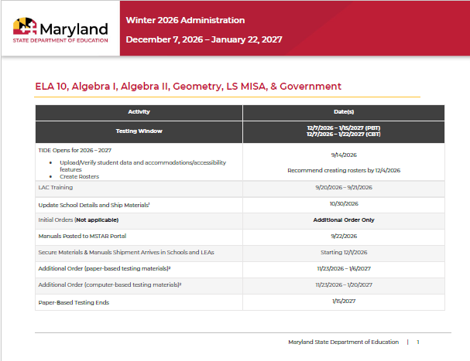
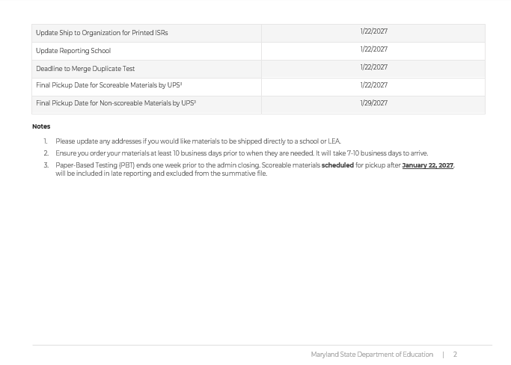
Winter 2026 Administration Dates
Key Dates
Winter Testing Window:
12/07/2026 - 1/15/2027 (PBT)
12/07/2026 - 01/22/2027 (CBT)
Launch Pad is open for 2026-2027
TIDE Platform will be open for 2026-2027 administrations starting: 9/14/2026
Full Administration Reporting Key Dates located on MSTAR Portal
Disclaimer:
Please be advised that administration dates are subject to change due to unforeseen delays or disruptions. The Maryland State Department of Education (MSDE) reserves the right to modify these dates as circumstances warrant.
https://support.mdassessments.com/training-resources/
Notes:
Pearson Heather -

Slide 8
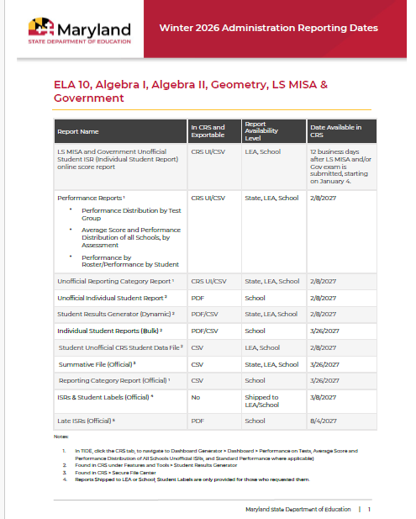
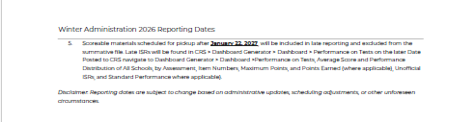
Winter 2026 Reporting Dates
Key Dates
NOTE: Final Pickup date for Scorable
Materials is 1/22/2027. Materials picked up by UPS after 1/22/2027 will be included in
late reporting and excluded from the
Summative File.
Reports are routinely scheduled for release by 6:00 PM EST, though early availability is possible.
Full Reporting Key Dates located on MSTAR Portal
Disclaimer:
Please be advised that reporting dates are subject to change due to unforeseen delays or disruptions in the administration. The Maryland State Department of Education (MSDE) reserves the right to modify these dates as circumstances warrant.
https://support.mdassessments.com/reporting/
Notes:
Pearson Heather -

Slide 9
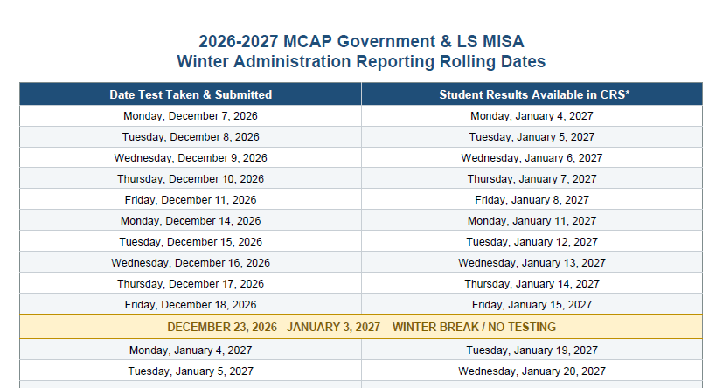
2026-2027 Winter Government & LS MISA Rolling Dates
Key Dates
Students results are available 12 days after the test is taken and exam is submitted.
Example: Test taken on January 4, 2027 test results will be provided on January 19, 2027
Keep in mind Winter Break is December 23-January 3, 2027
Government & LS MISA schedule dates (Exam Test Taken/Submitted & Student Results Available in CRS) located on MSTAR Portal early next week.

Slide 10
Winter Milestones
Key Dates
Additional TIDE/TDS Dates
Now! | MSTAR Secure Browser Available for Download
September 9, 2026 | Winter 2026 LAC Training – Virtual
September 10, 2026 | Winter Training Virtual Office Hours
September 14, 2026 | Test Information Distribution Engine (TIDE) Go Live
September 14, – October 24, 2026 | Winter Custom Trainings (optional)
October 5, 2026 | ELA, Math, Science, Social Studies Practice Test Go Live
November 7, 2026 | LS MISA and Government Practice Test Go Live
December 7, 2026 | Winter EOC Operational Test Go Live ELA G10, Algebra I, Algebra II, Geometry, LS MISA, Government
Jan 4, 2027 | LS MISA and Government scores go live and will continue to populate 12 business days after a student completes tests and submits
February 8, 2027 | ELA G10, Algebra I, Algebra II and Geometry preliminary score Go Live
March 8, 2027 | Winter EOC ISR Paper Score Reports and Labels arrive in LEAs
Notes:
Brianna - On this slide, we will focus on the Fall/Winter Milestones.
The key points are Additional TIDE/TDS Dates; July 16, 2026 | MSTAR Secure Browser Available to Download; September 9, 2026 | Fall 2026 LAC Training - Virtual; September 10, 2026 | Fall Training Virtual Office Hours=; September 14, 2026 | Test Information Distribution Engine (TIDE) Go Live.
Please use the MSTAR Portal as the source for the full schedule and monitor communications for updates.

Slide 11
New for SY26-27!
MSTAR Assessment Systems
Notes:
Brianna - On this slide, we will focus on what is new for SY26-27.

Slide 12
Administration Requirements
Getting Started
Launchpad
Upload System Users
Students
STCs
TIDE
Registration
Rostering
TDS
Test Administration
CRS Reporting
Initial and final score reporting post test administration
Initial and Additional Orders
Test Administrator Interface
Reporting Administrators
Accommodations
Manage Student Transfers (LAC Only)
Monitoring Student Progress During and After Testing
Test Tickets
Student Interface
TA Session IDs
Monitor students while testing in the online session
Rosters created in TIDE will allow TAs to see the student score reports for the students who tested with them in their TA Session.
Individual Score Report (ISRS) and downloadable score result data files
Notes:
Brianna - This slide represents how users will move through the test registration and administration platforms. Users who will be accessing the system are also represented here.
Launchpad will be available similar to previous years and all users and students will need to be added to Launchpad first. Launchpad will send this data to TIDE, TDS and Reporting.
Once users and students are in TIDE, designated users will be able to add accommodations and test settings to student profiles in advance of testing. All accommodations must be selected and verified before the students begin testing. Once accommodations and test settings are selected for students, this information will be retained for the rest of the school year – it only has to be done once for the Winter, Spring and Summer administrations.

Slide 13
SY26-27 MSTAR Systems
Starting with the Winter admin, and the assessments that will be both be administered under MSTAR's umbrella in the new system. System definitions:
LP: LaunchPad offers a unified login experience, giving users centralized access to their assessment applications.
TIDE: Registration system used to student assignment tags and accommodations, submit reset and invalidation requests, order additional paper materials, and monitor student test progress.
TDS: The core platform that students use to take secure tests, and that teachers use to manage and monitor live exam sessions.
CRS: The online, dynamic reporting system that LEA, School and Test Administrators (and Teachers) will access their student score reports..
Family Portal: The online, dynamic reporting system that parents and guardians will use to access their student score reports. Access will be provided via TIDE to parents and guardians.
Notes:
Brianna – Will read the slide contents

Slide 14
Preparing for Test Administration with Launchpad
Before Testing
Notes:
Brianna - On this slide, we will focus on Preparing for Test Administration with Launchpad, which is a system that Maryland users are already familiar with from past administrations. I will now turn it over to Kim

Slide 15
Launchpad
Launchpad
Logging in
Roles
Required Fields
Importing Users
Students
Non-Students
Welcome Emails
Transfer Requests
Notes:
Kim

Slide 16
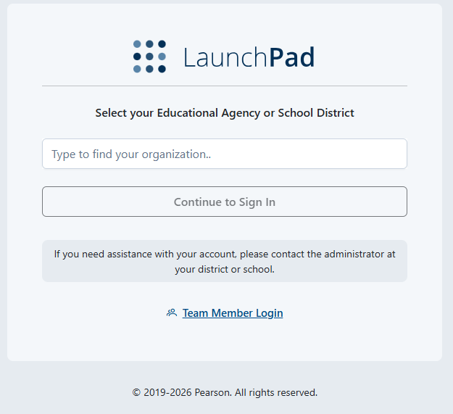
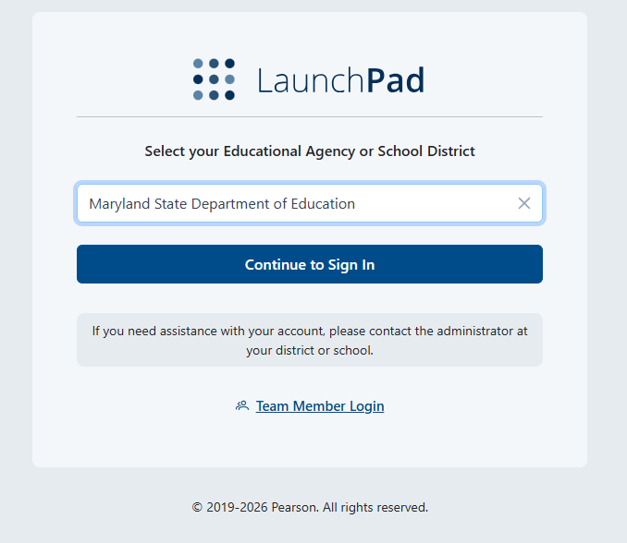
Launchpad Select option
Launchpad
Access Launchpad via the following web address: https://launchpad.pearson.com
Notes:
Kim

Slide 17
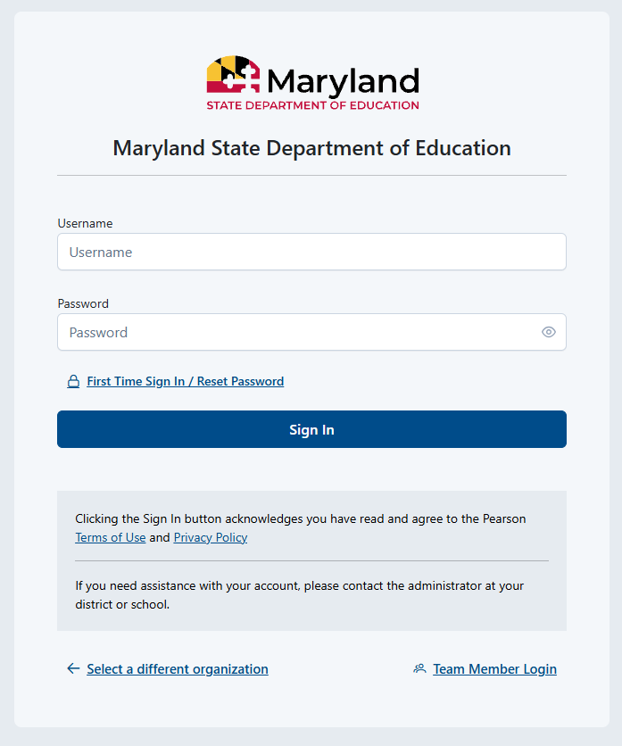
Launchpad: Logging in
Launchpad
Notes:
Kim

Slide 18
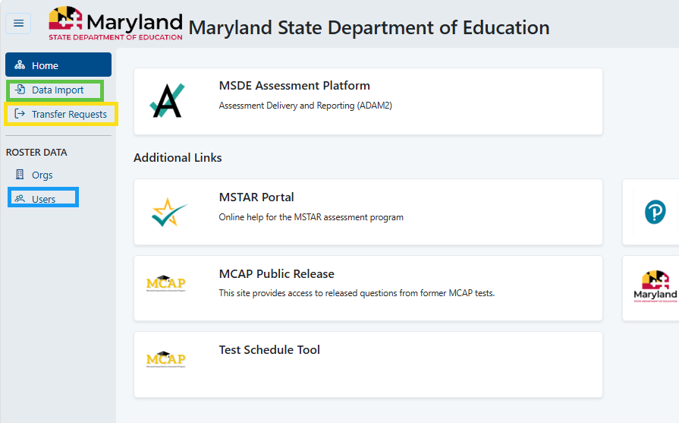
Launchpad: Home Page
Launchpad
The home page offers access to different applications that you will need to use during an administration.
Data Import provides the ability to upload student and non-student users
Transfers provides access to initiate and accept/deny transfer requests
Users allows the ability to view student and non-student user data.
Notes:
Kim

Slide 19
User Accounts: General Information
Launchpad
User accounts need to be monitored at the school level.
User accounts must be set up using a school email.
If there is an email change a new user account will need to be created.
New user will receive a welcome email that must be responded to with in five days or it will expire.
Welcome emails can be sent automatically at account creation or can be sent manually at a later time.
Notes:
Kim

Slide 20
User Role Mapping – Launchpad and TIDE
Launchpad
User Role Matrix – TIDE and Launchpad
New Roles
  Special Education, Hotline, Reporting LEA and School Roles
Determines which users have access to which Pearson applications
Access to PII Information (TIDE versus CRS)
CRS Access
  LACs will access all information in the LEA (district level)
  School Test Coordinators will access all information in the School
  TAs will need a roster associated to view student scores
Notes:
Kim

Slide 21
User Role Mapping – Launchpad and TIDE
User Role (2026-2027) | Primary Responsibilities | Previous Role in ADAM
Local Accountability Coordinator (LAC) | Serves as the primary district assessment coordinator responsible for local assessment administration and accountability activities. | Local Accountability Coordinator
School Test Coordinator (STC) | Coordinates assessment administration at the school level and ensures testing readiness. | School Test Coordinator
Special Education Coordinator (SPED) | Ensures students with disabilities receive appropriate accommodations and accessibility supports. | New Role!
Notes:
Celine – We briefly discussed user roles early in this presentation and will now take a deeper dive into exactly what the different user roles in TIDE can and cannot do before, during and after the test administration. Note that in TIDE, the same user can have multiple test administration responsibilities. For example, an STC might also have the role of Hotline Direct user.
CAI will read the slide and remind users to pay close attention to where the work is performed and which role has authority to complete or approve the task.

Slide 22
User Role Mapping – Launchpad and TIDE
User Role (2026-2027) | Primary Responsibilities | Previous Role in ADAM
Test Administrator (TA) | Increased Responsibility! Administers assessments to students and manages classroom-level testing activities. | Test Administrator
Hotline Direct Administrator (HLD) | Monitors and acts on Learning in Danger resolution for districts and schools and supports operational testing operations within the user's jurisdiction. | New Role!
District Reporting Administrator (DRA) | Reviews district-level participation and assessment results and supports district assessment coordination. | District Reporting Administrator
Reporting Administrator (RA) | Reviews school-level reports and assessment participation information. | Report Administrator
Notes:
Celine - On this slide, we will focus on Overview of LAC, STC, TA Roles and Responsibilities and how these roles were labeled in ADAM, if applicable
The Special Education Coordinator (SPED) is a new user role for SY26-27. Read through the slide.
The Test Administrator (TA) role will have more direct involvement in the test administration then in previous years.

Slide 23
User Roles and Primary Responsibilities
User Role | Level of Access | LaunchPad Responsibilities | TIDE Responsibilities | TDS Responsibilities | CRS Responsibilities
LAC | LEA | Adds and Manages Students & Student Demographic Information Adds and Manages Non-Student Users Transfers Students | Adds and Manages Student Accommodations Adds and Manages Student Assignment Tags Uploads Interim Grades Creates Rosters Submits Additional Orders Prints Test Tickets and PreID Labels Approves Resets and Invalidations Submitted in TIDE Monitors Test Progress Adds Student Reason Not Assessed | N/A | Views Student Score Results
SPED | School | N/A | Adds and Manages Student Accommodations Creates Rosters Uploads Interim Grades | N/A | Views Student Score Results
Notes:
Celine - This slide discusses the responsibilities for users across the online systems. All users will have access to Student Personal Identifiable Information as all these systems use a Student’s Full Name and SASID to identify a student.

Slide 24
User Roles and Primary Responsibilities
User Role | Level of Access | LaunchPad Responsibilities | TIDE Responsibilities | TDS Responsibilities | CRS Responsibilities
HLD | LEA | N/A | Receives Learner in Danger Reports Same level of access as LAC | N/A | Views Student Score Results
STC | School | Adds and Manages Students & Student Demographic Information Adds and Manages Non-Student Users | Adds and Manages Student Accommodations Adds and Manages Student Assignment Tags Uploads Interim Grades Creates Rosters for TAs Submits Additional Orders Prints Test Tickets and PreID Labels Submits Resets and Invalidations Submitted in TIDE Monitors Test Progress | N/A | Views Student Score Results
Notes:
Celine - This slide discusses the responsibilities for users across the online systems

Slide 25
User Roles and Primary Responsibilities
User Role | Level of Access | LaunchPad Responsibilities | TIDE Responsibilities | TDS Responsibilities | CRS Responsibilities
TA | School | N/A | Views Student Accommodations Uploads Interim Grades Cannot Create Rosters Prints Test Tickets and PreID Labels | Creates Test Sessions Monitors Students During Testing | Views Student Score Results
DRA | LEA | N/A | Uploads Interim Grades Views Resets and Invalidations | N/A | Views Student Score Results
RA | School | N/A | Views Resets and Invalidations | N/A | Views Student Score Results
Notes:
Celine - This slide discusses the responsibilities for users across the online systems

Slide 26
Required Fields: Reminder
Launchpad
SASID
Grade
School/Organization
Date of Birth
Gender
Race
Ethnicity
IEP
Limited English Proficiency
Section 504
Local ID
Economic Disadvantage
*NOTE: Temporary SASIDs are not allowed.
Notes:
Kim - Before importing the file make sure all the required fields entered based on the vendor field definitions.

Slide 27
Fields Available but not Required
Launchpad
Fields on Student Import in Launchpad (Not Required)
preferredGivenName
preferredMiddleName
preferredLastName
pronouns
Notes:
Kim -

Slide 28
Primary Disability Type (Valid Values)
Launchpad
Current Fields on Import – Primary Disability Type
AUT = Autism
DB = Deaf-blindness
DD = Developmental delay
EMN = Emotional disturbance
HI = Hearing impairment
ID = Intellectual disability
MD = Multiple disabilities
OI = Orthopedic impairment
OHI = Other health impairment
SLD = Specific learning disability
SLI = Speech or language impairment
TBI = Traumatic brain injury
VI = Visual impairment
Blank = Not specified
Notes:
Kim -

Slide 29
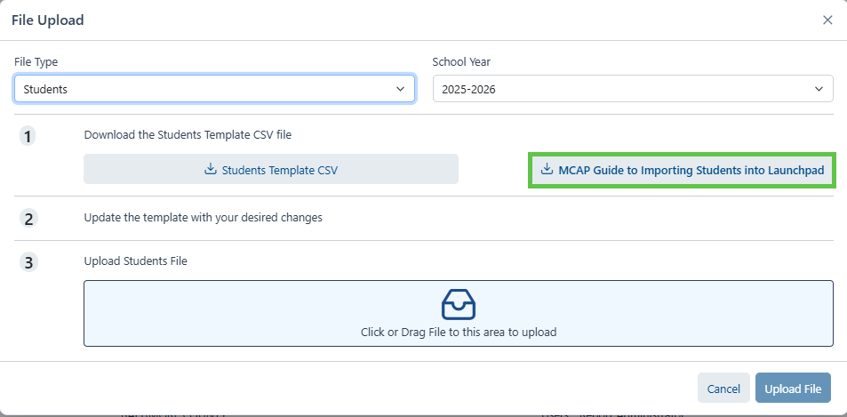
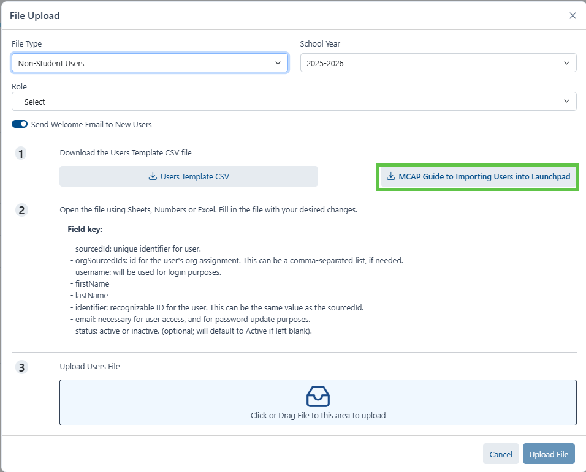
Guide to Importing Users
Launchpad
Available from the file upload screen
You can pull the guide from the upload screen itself as well as the MCAP Portal.
Notes:
Kim -

Slide 30
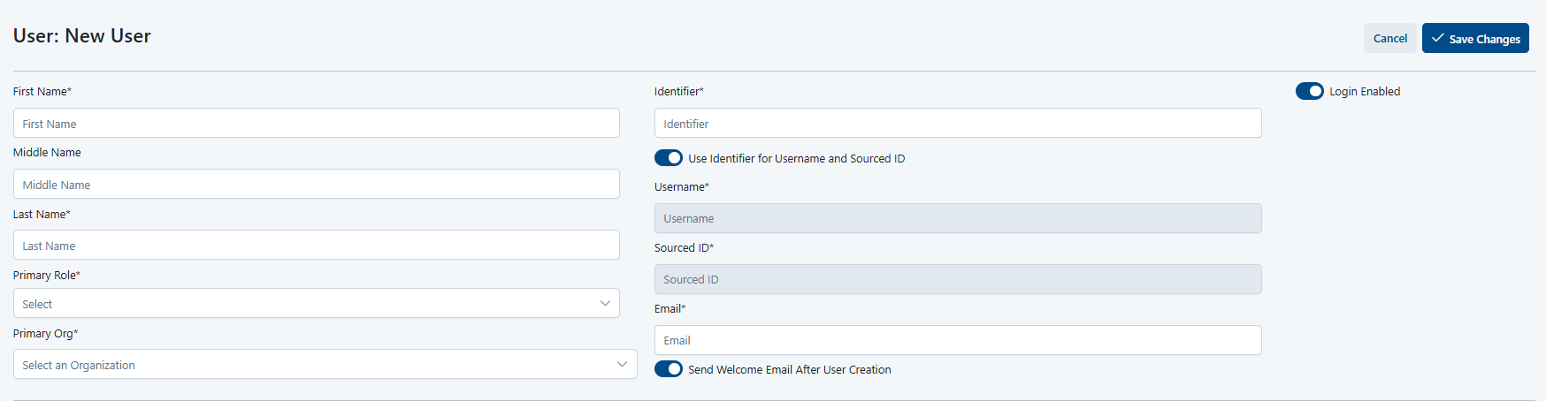
Creating Non-Student Users (UI)
Launchpad
Users > Actions > Create New User
Fill out required information, including role
Toggle off if you don’t want welcome email sent automatically after creation.
Save Changes
Notes:
Kim -

Slide 31
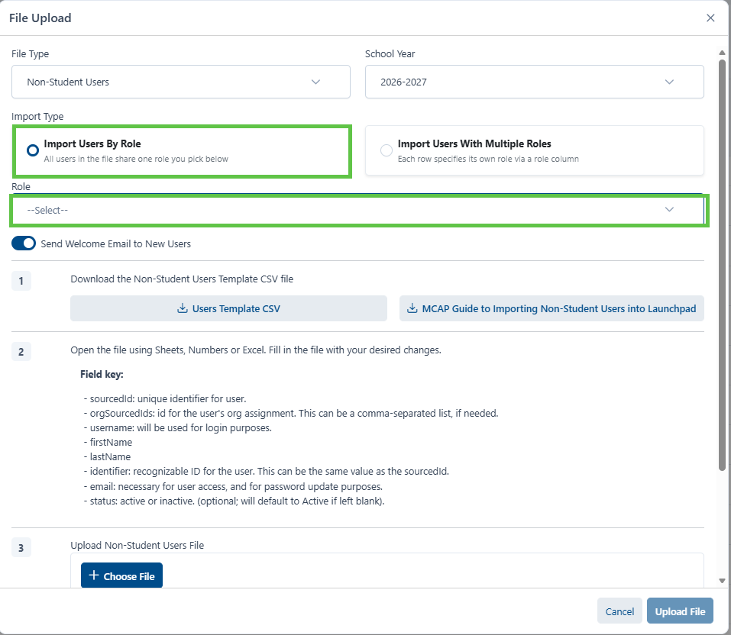
Creating Non-Student Users Same Role (Import)
Launchpad
Data Import > Upload File
File type > Non-Student Users
Make sure school year is 2026-2027
Select Role
Click toggle off to not send welcome email at creation
Download Users Template
Fill out required information > Save as CSV UTF-8
Click Choose file and attach saved file > Upload File
**Note: Guide to Importing Non-Student is attached for reference
Notes:
Kim -

Slide 32
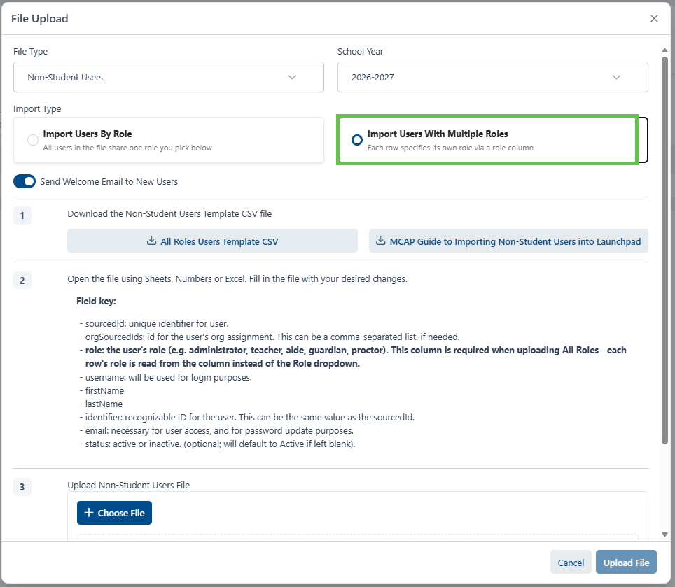
**NEW Creating Non-Student Users Multiple Roles (Import)
Launchpad
Data Import > Upload File
File type > Non-Student Users
Make sure school year is 2026-2027
Click toggle off to not send welcome email at creation
Download Users Template
Fill out required information > Save as CSV UTF-8
Click Choose file and attach saved file > Upload File
**Note: Guide to Importing Non-Student is attached for reference
Notes:
Kim -

Slide 33

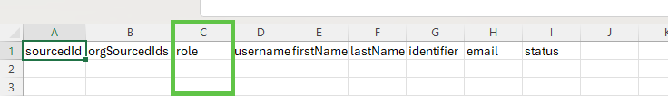
Creating Non-Student Users (Import Updates)
Launchpad
Creating Non-Student Users Same Role
Creating Non-Student Users Multiple Roles
**Note: Role names must match the display name configured in the account. One row per user, per role, per org is required.
Notes:
Kim – Demo in LP, pull up data import for single and multiple.

Slide 34
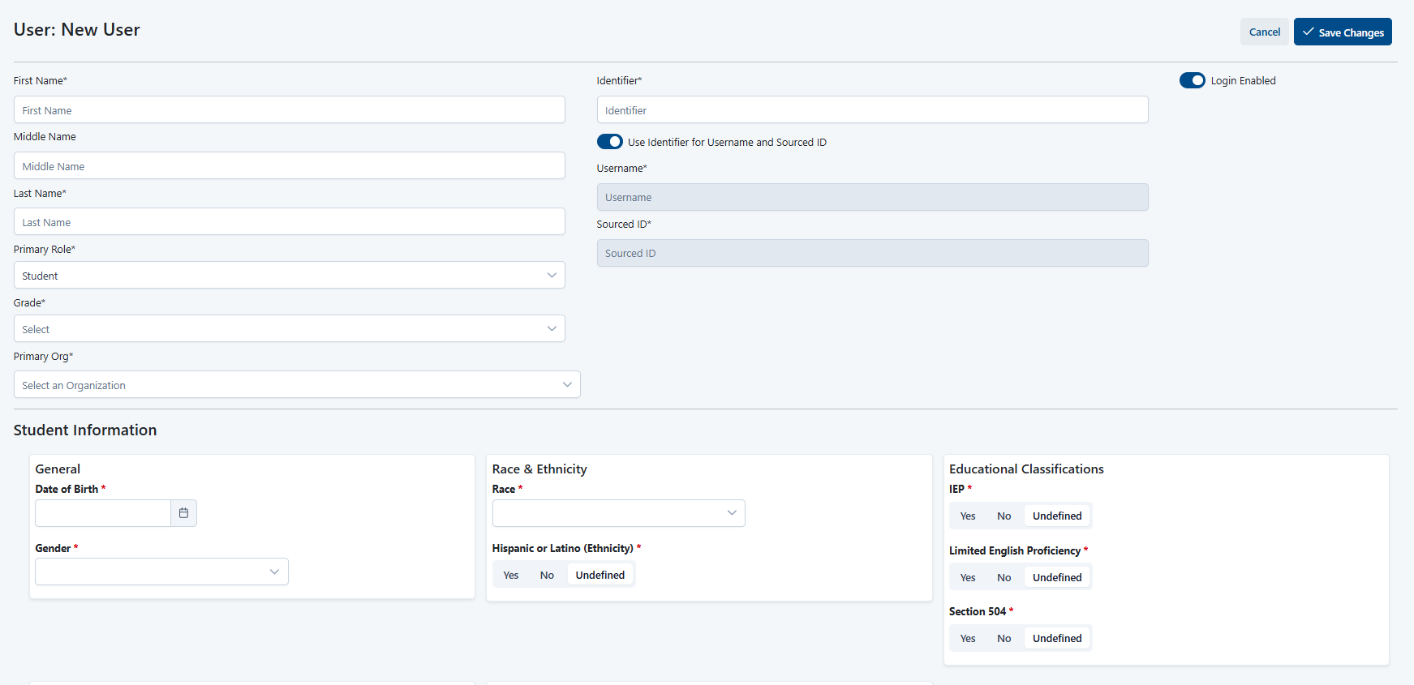
Creating Student Users (UI)
Launchpad
Users > Actions > Create New User
Fill out required information (All required information has a red asterisk)
Save Changes
Notes:
Kim -

Slide 35
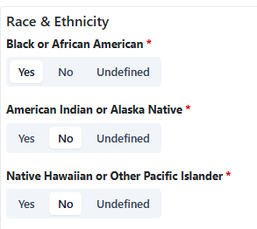
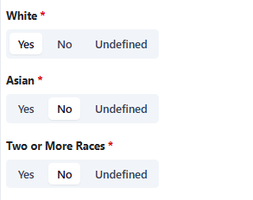
**NEW Creating Student Users (Update)
Launchpad
Update to Race & Ethnicity
Nothing changing on import
This is now a multi-select field (UI)
You can now select multiple races in the (UI)
Allows the user to update student race without losing what was on the import.
Notes:
Kim -

Slide 36
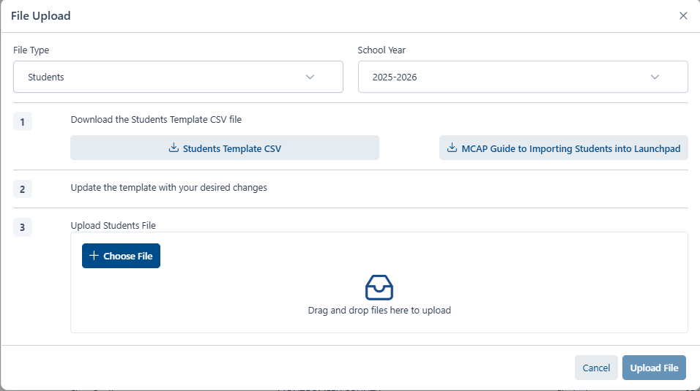
Creating Student Users (Import)
Launchpad
Data Import > Upload File
File type > Students
Make sure school year is 2026-2027
Download Students Template
Fill out required information
Save as CSV UTF-8
Click Choose file and attach saved file
Upload File
**Note: Guide to Importing Students is attached for reference
Notes:
Kim -

Slide 37
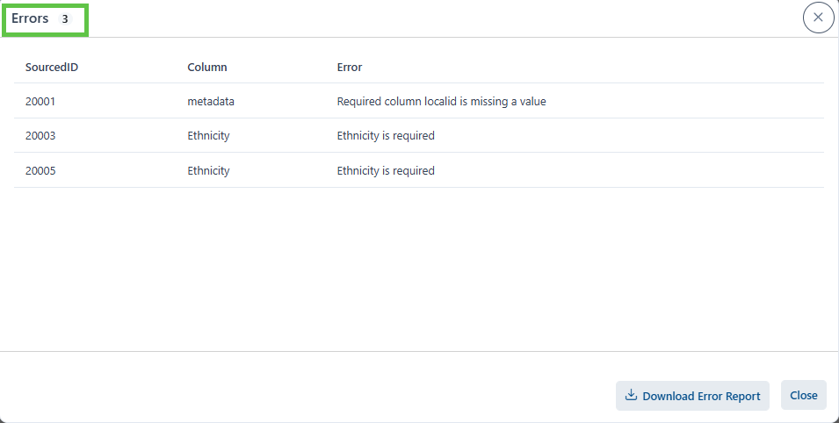
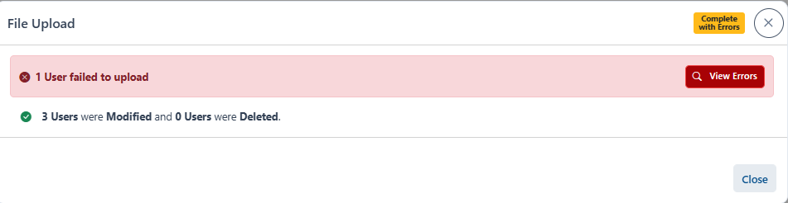
Error Message Example
Launchpad
Error message in Launchpad is clear and concise
Notes:
Kim - Indicates Sourced ID Column and what the error is.

Slide 38
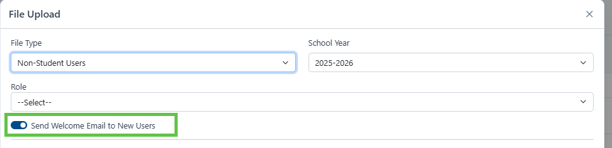
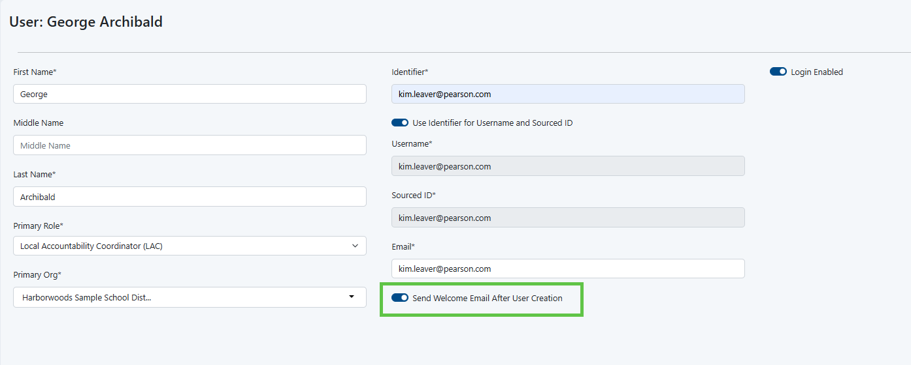
Welcome Emails
Launchpad
You can choose to send a welcome email to a user upon creation, either through the UI or via import
*Note: Welcome Emails will come from: noreply@mail.launchpad.pearson.com
Notes:
Kim -

Slide 39
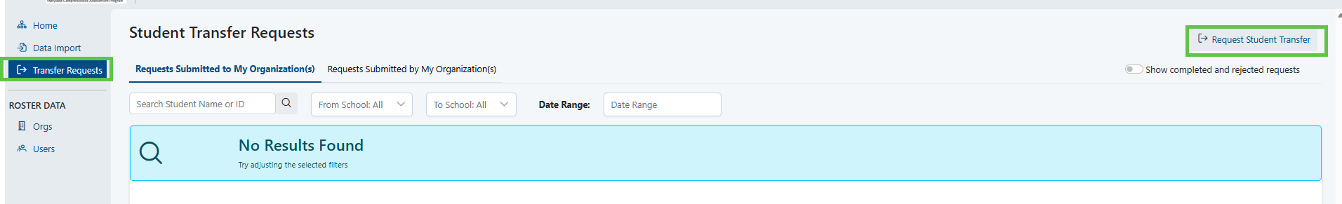
Initiating a Transfer Request (LAC Only)
Launchpad
To initiate a transfer in Launchpad Transfer Requests > Request Student Transfer
*Transfer request will be handled by LACs
Notes:
Kim -

Slide 40
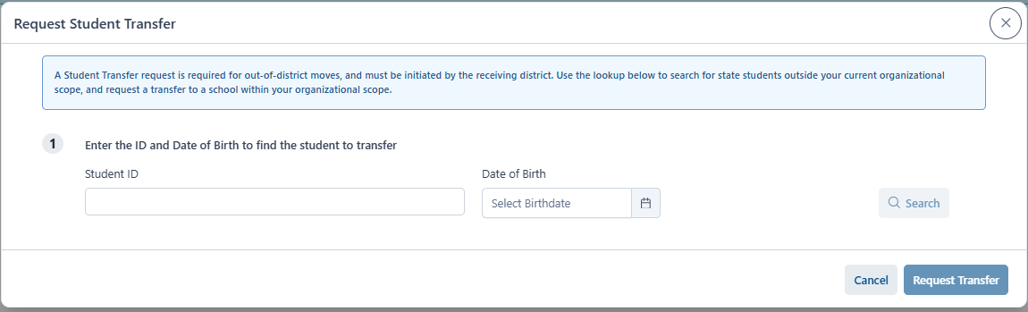
Steps to Request Student Transfer (LAC Only)
Launchpad
Must have Student ID and Date of Birth
Enter > Click Request Transfer
Notes:
Kim -

Slide 41
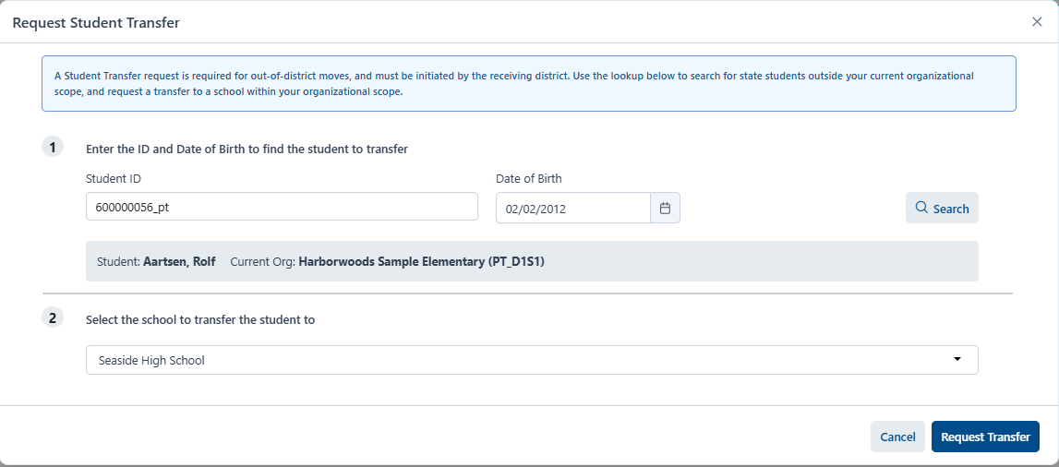
Transfer Requests Continued (LAC Only)
Launchpad
Select the school that you the student should be transferred to > Request Transfer
Transfer will be submitted and the LAC at the school student is transferring from will have to approve transfer for transfer to be completed.
Notes:
Kim -

Slide 42
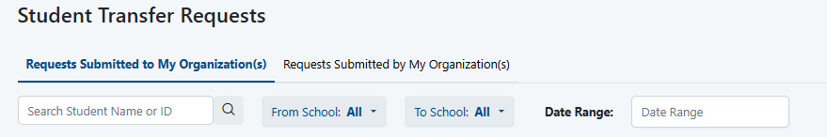
Search Transfer Requests (LAC Only)
Launchpad
There is a search bar to easily find Transfer requests
Notes:
Kim -

Slide 43
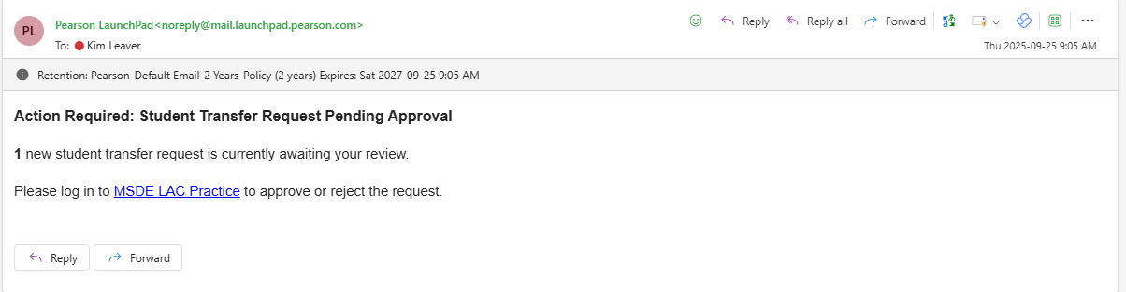
Transfer Requests Email Notification (LAC Only)
Launchpad
Email notifications will be generated when transfer is initiated to transfer student from LEA to LEA.
Email will come from: noreply@mail.launchpad.pearson.com
Notes:
Kim -

Slide 44
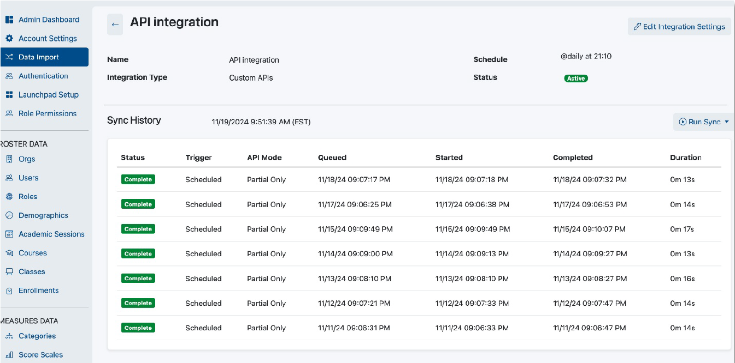
Launchpad
Launchpad
What is staying the same with MSTAR:
Importing Student Users
Importing Non-Student Users
Transfer Requests
Homeschool Students
LEA 24
Source of truth
Notes:
Kim

Slide 45
Launchpad will continue to be used for:
Launchpad
Authenticates users (students, teachers, test coordinators, administrators)
Receives roster and enrollment information from districts
Creates the organizational hierarchy (district → school)
Provides single sign-on (SSO) into assessment applications
Determines which users have access to which Pearson applications
Supports integrations with district Student Information Systems (SIS) and identity providers
Provides the foundation for accessing systems such as testing, reporting, and administration
Notes:
Kim – As a reminder, Launchpad will continue to be used for the following:
The key points are Authenticates users (students, teachers, test coordinators, administrators) Receives roster and enrollment information from districts Creates the organizational hierarchy (district → school → class) Provides single sign-on (SSO) into assessment applications; Launchpad.
With that context, let us move to the next step in the process.

Slide 46
MSTAR: Introduction to TIDE
Introduction to TIDE
TIDE Dashboard
Notes:
Kim – I will now turn this slilde over to (CAI) This section will introduce TIDE and how it connects with Launchpad and the larger MSTAR assessment program before, during and after testing.
We will reconfirm user roles, introduce users to the TIDE platform and review the TIDE dashboard.

Slide 47
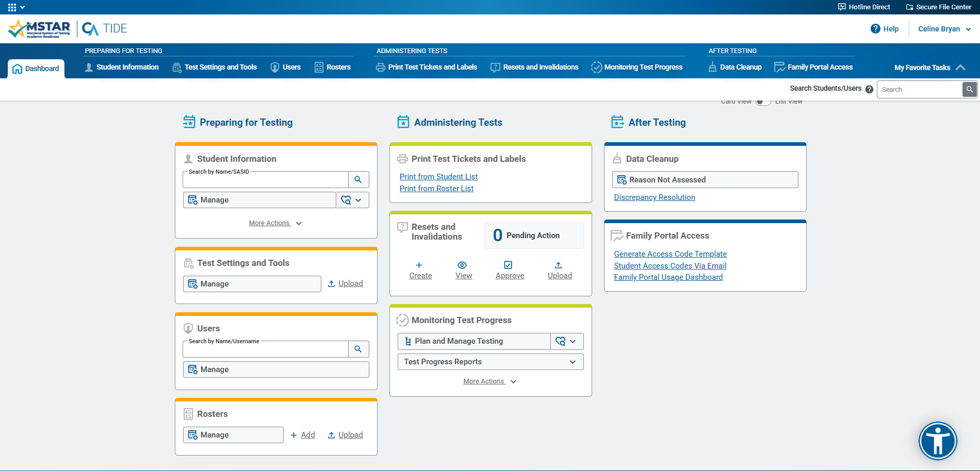
MSTAR: TIDE Dashboard
Notes:
Celine – This slide represents the TIDE Dashboard Home Screen. As you can see it is clearly divided into Preparing for, Administering and After Testing. This grouping is intentional to provide a clear path in the system of what needs to be done for students before, during and after testing.

Slide 48
TIDE: Preparing for Testing
Users Involved
  LACs
  STCs
  ML/IEP Coordinators (SPED)
Notes:
Celine – Let's start with Preparing for Testing. We will discuss the different responsibilities in the system for LACs, STCs, and SPED users.

Slide 49
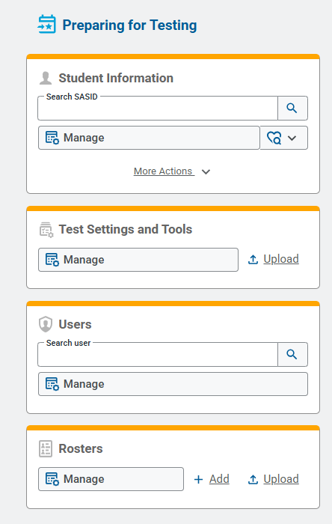
TIDE: Preparing for Testing
Adding and Editing Student Accommodations and Test Settings
Working with Student Rosters
Printing Student Pre-ID Test Tickets and Paper-Pencil Test Labels
Working with Additional Orders
Adding Assignment Tags for End of Course (EOC) student testing eligibility
Notes:
Celine – We will go over several tasks that need to be done in TIDE prior to student testing including adding assignment tags for students who take the End of Course (EOC) assessments, managing test settings and tools for students including accommodations, managing and creating rosters, and working with paper pencil initial and additional orders.

Slide 50
TIDE: User Roles and Permissions
Preparing for Testing
Preparing for Testing TIDE Tasks | Local Accountability Coordinator (LAC) | School Test Coordinator (STC) | Special Education Coordinator (SPED) | Test Administrator (TA)
Adding and Editing Student Accommodations and Test Settings | ✓ | ✓ | ✓
Working with Student Rosters | ✓ | ✓✓ |  | ✓
Printing Student PreID Labels and Test Tickets | ✓ | ✓ | ✓ | ✓
Working with Additional Orders | ✓ | ✓
Adding Assignment Tags for End of Course (EOC) student testing eligibility | ✓ | ✓ | ✓ | ✓
Notes:
Celine – The following users are involved with different activities in TIDE and we will go through their responsibilities as we proceed through this presentation. This slide represents the different roles and responsibilities for different users based on system access. For example, TAs do not have the ability to add and edit student accommodations in TIDE while LACs, STCs and SPED users do have this access. All users have the ability to print student pre-ID paper test labels and test tickets that can be provided to students before testing for ease of login into TDS.

Slide 51
Preparing for Testing
LaunchPad | TIDE
Data import, Add, and Manage users (LACs, Test Administrators, etc.) Information | Add Student Accommodations, Test Assignment Tags, and Test Settings
Add and Manage Student Demographic Information | Add and Manage Student Rosters
 | Print Test Tickets and Pre-ID Labels
 | Order Additional Paper Testing Materials
Notes:
Celine – As a reminder, there are distinct responsibilities and capabilities available users depending if they are in Launchpad or in TIDE. This slide provides a quick reminder of which system has which capability.

Slide 52
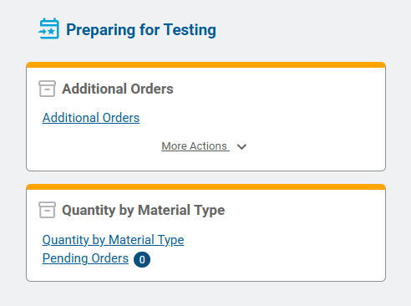
LAC & STC Preparing for Testing Responsibilities
Preparing for Testing
Work with IEP/ML Coordinators to set Test Settings and Tools (and accommodations) for all Students in LEA/school.
LACs will add Test Assignment Tags
Coordinate with TAs to create Rosters, as needed.
Coordinate with TAs to Print Student Test Tickets and PreID Labels, as needed.
Order Additional Materials, as needed.
Notes:
Celine – Here is a summary of the various responsibilities an LAC and STC will have before testing. We will go through each of them in the subsequent slides.

Slide 53
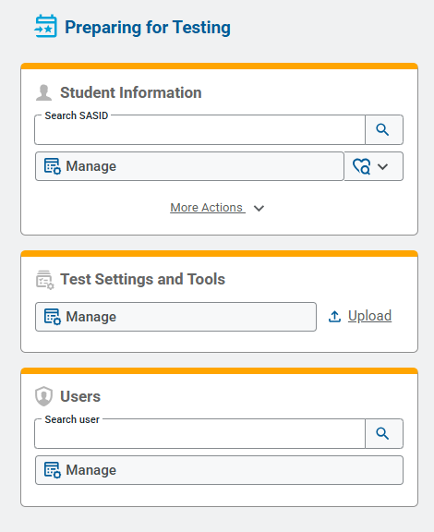
TIDE: IEP/ML Coordinator (SPED)
Preparing for Testing Responsibility
Preparing for Testing
Work with LACs and STCs to set Test Settings and Tools (and accommodations) for all Students in School
Notes:
Celine – On this slide, we will focus on IEP/ML Coordinator (SPED) Preparing for Testing Responsibility.
The key points are Work with LACs and STCs to set Test Settings and Tools (and accommodations) for all Students in School; Preparing for Testing.
Pay close attention to where the work is performed and which role has authority to complete or approve the task.

Slide 54
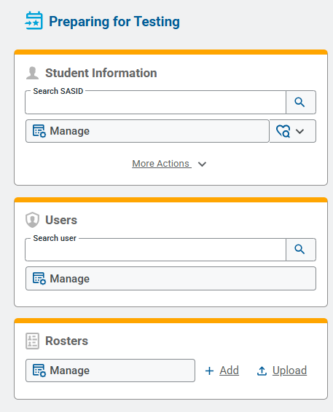
TIDE: TA Preparing for Testing Responsibilities
Preparing for Testing
Coordinate with STCs to create and view Rosters, as needed.
View student Test Settings and Tools (accommodations)
View student Test Assignments
Print student Test Tickets.
Print student Pre-ID Labels, as needed.
Notes:
Celine – On this slide, we will focus on TA Preparing for Testing Responsibilities.
The key points are Coordinate with STCs to create and view Rosters, as needed. View student Test Settings and Tools (accommodations) View student Test Assignments Print student Test Tickets. Print student Pre-ID Labels, as needed; Preparing for Testing.
Pay close attention to where the work is performed and which role has authority to complete or approve the task.

Slide 55
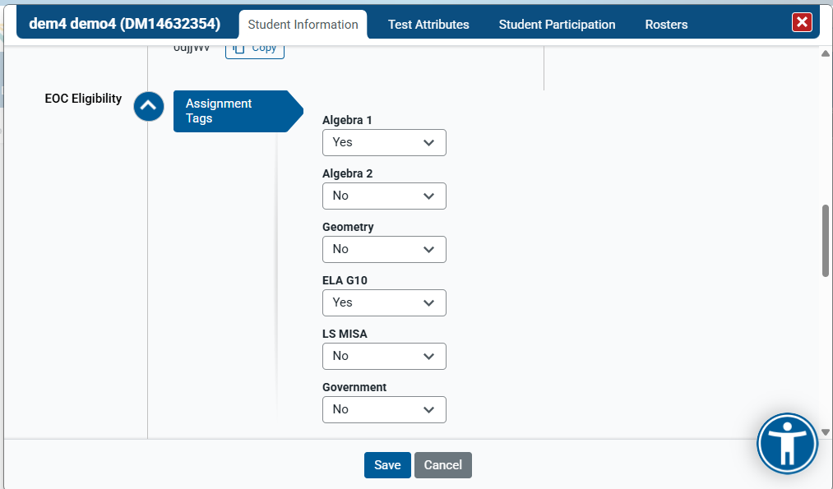
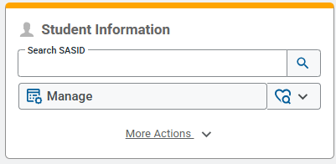
TIDE: Student Assignment Tags
Preparing for Testing
Notes:
Celine – On this slide, we will focus on Student Assignment Tags.
While students will be added to TIDE via LaunchPad, STCs and LACs will need to upload or add assignment tags for their students in TIDE.

Slide 56
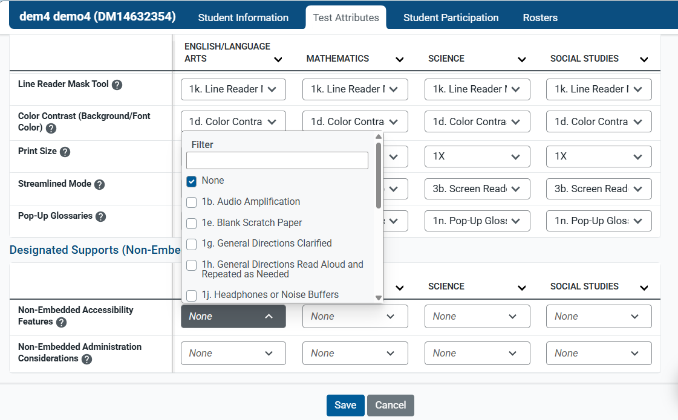
TIDE: Test Settings and Tools
Preparing for Testing
Notes:
Celine – TIDE keeps track of student test settings, accommodations, and accessibility, such as font size and text-to-speech. The Test Settings and Tools task menu allows you to manage or upload test settings and tools. The codes included on this tab correspond to the MAAM codes. LACs, STCs, and Special Education Coordinators will be responsible for adding and uploading student test settings and tools. In the next section of this training, we will go over each of the MAAM codes and how they are referenced in TIDE and in the Test Delivery System.

Slide 57
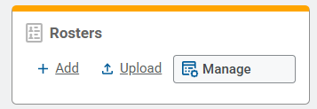
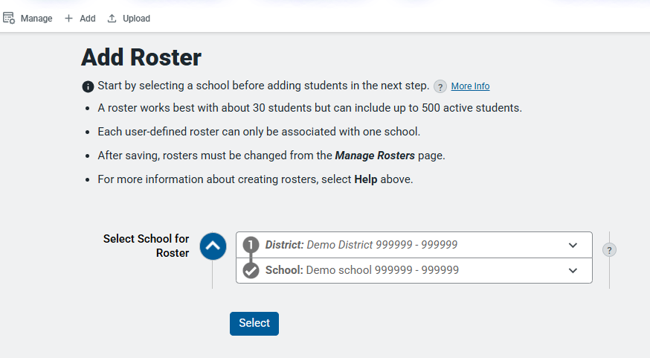
TIDE: Rosters
Preparing for Testing
Notes:
Celine – On this slide, we will focus on Rosters. While they are not required, they are recommended.
The primary purposes of rosters include:
Reporting & Score Access: Granting teachers and educators access to score reports and interim/summative assessment results in reporting systems (like CRS) specifically for the students they teach.
Test Administration & Operations: Allowing test administrators and proctors to manage testing sessions, monitor student test progress, and print testing materials (such as student test tickets) grouped conveniently by classroom or cohort.
Data Privacy & Security: Enforcing role-based access control and FERPA compliance by ensuring staff members can only view data, test settings, and score reports for students assigned to their rosters.
Flexible Student Grouping: Supporting custom student groups for specialized classes, intervention groups, or testing attendance centers.

Slide 58
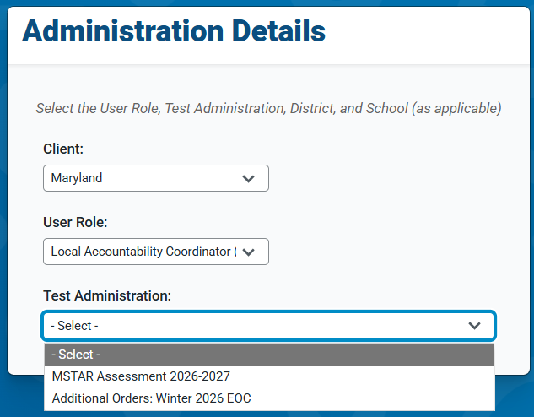
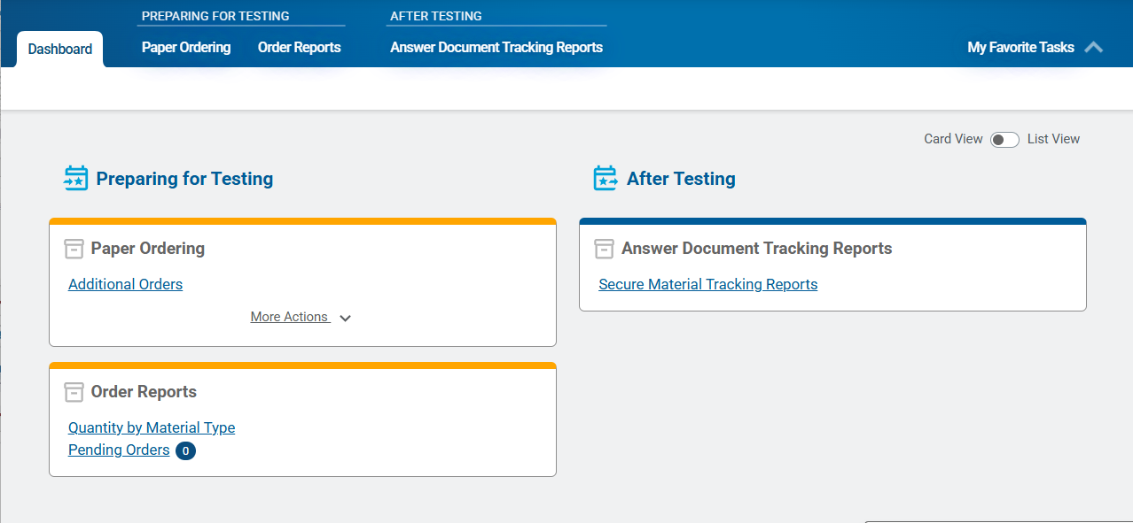
TIDE: Orders
Preparing for Testing
Administration | Types of Orders
Winter 2026 EOC | Additional Orders Only
Spring 2027 Onward | Initial Order via PreID Additional Order Window
Notes:
Celine – All orders will be included in a separate administration in TIDE. When you select an Additional Orders administration in TIDE, [1] the dashboard will be similar like this one.
[2] This chart illustrates Types of Orders; Winter 2026 EOC | Additional Orders Only; Spring 2027 Onward | Initial Order via PreID Additional Order Window.

Slide 59
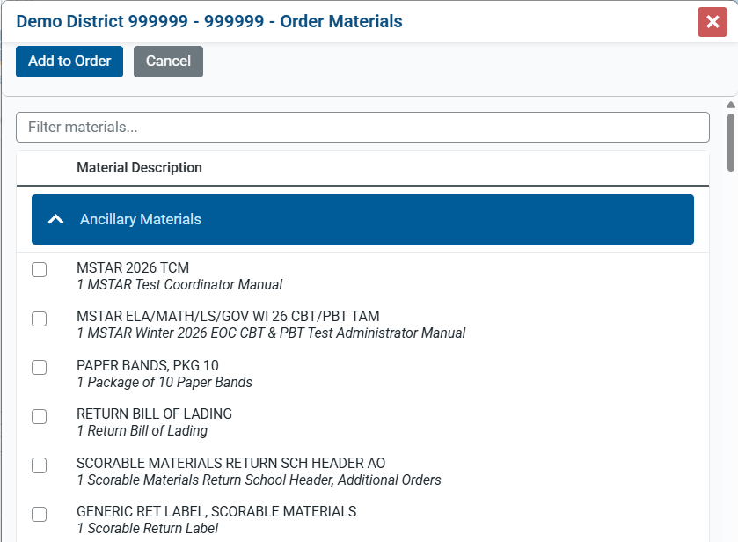
TIDE: Additional Orders
Preparing for Testing
  LACs and STCs will order additional materials in TIDE.
  Approval Thresholds will remain the same as in previous years.
Notes:
Celine

Slide 60
TIDE: Approval Thresholds
Preparing for Testing
Material Type | Automatic Approval Limit
TCM | 1
TAM | 15
Return Materials Paper Bands Return Bill of Lading Scorable Materials Return School Header Generic Return Label, Scorable Materials Generic Return Label, Non Scorable Materials | 0
All Paper Kits English Print and Large Print Kits English and Spanish Human Reader Scripts Spanish Print and Large Print Kits English and Spanish Read Aloud Scripts Braille Kits | 10
Notes:
Celine

Slide 61
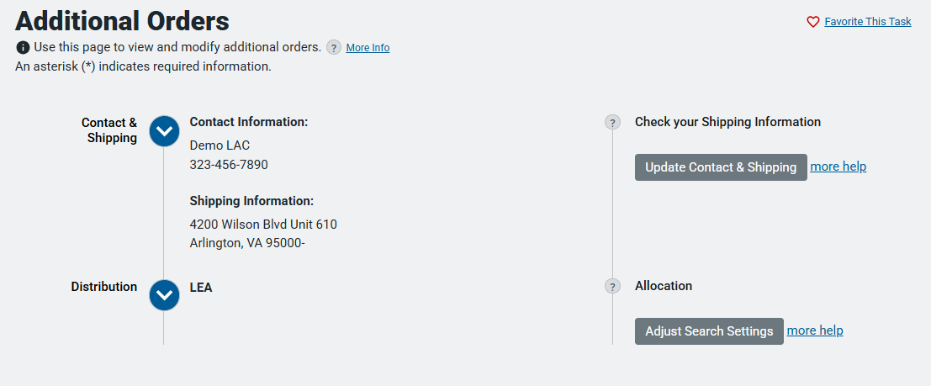
TIDE: Additional Orders
Preparing for Testing
Notes:
CelineTo place an additional, select Additional Orders. [1] The Additional Orders page opens.
Review your Contact and Shipping Information. If you need to revise it, select Update Contact & Shipping on the right side of the page. Make the edits, and then select Verify Contact.
You may also revise whether you are placing an order at the LEA or School Level in the Distribution section.
When you open this page, an order number is automatically generated

Slide 62
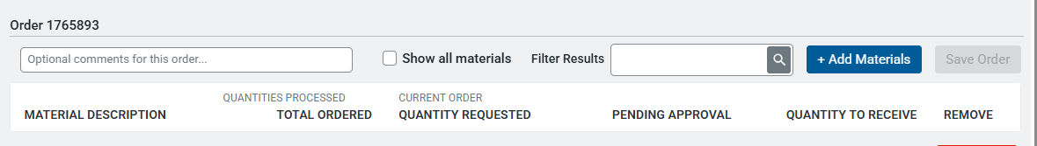
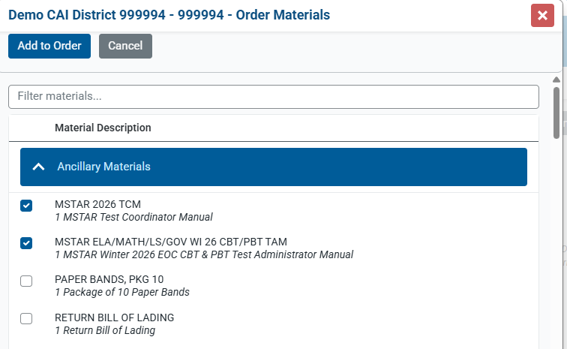
TIDE: Additional Orders
Preparing for Testing
Notes:
Celine Select +Add Materials. [1] A window will open. Check the materials you want to order and select Add to Order

Slide 63
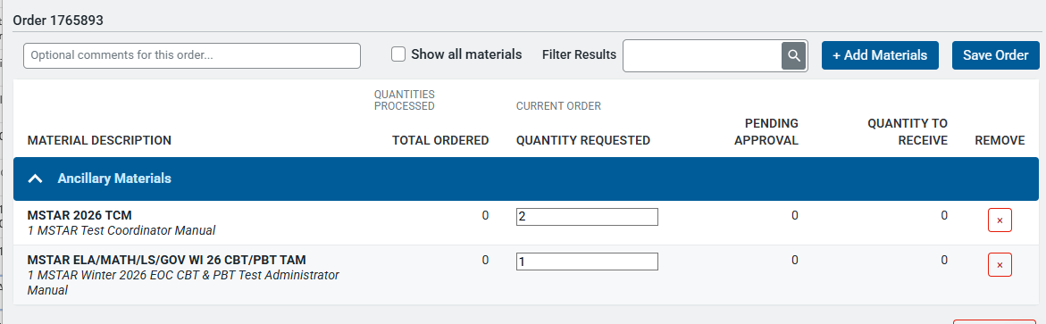
TIDE: Additional Orders
Preparing for Testing
Notes:
Celine The Window will close and you will see the materials you selected will show up in the list of orders. Enter the quantity for each material you selected. Then, click Save Order.

Slide 64
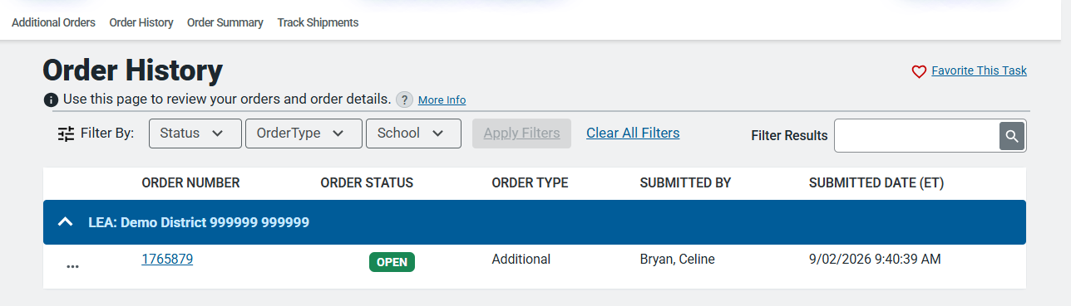
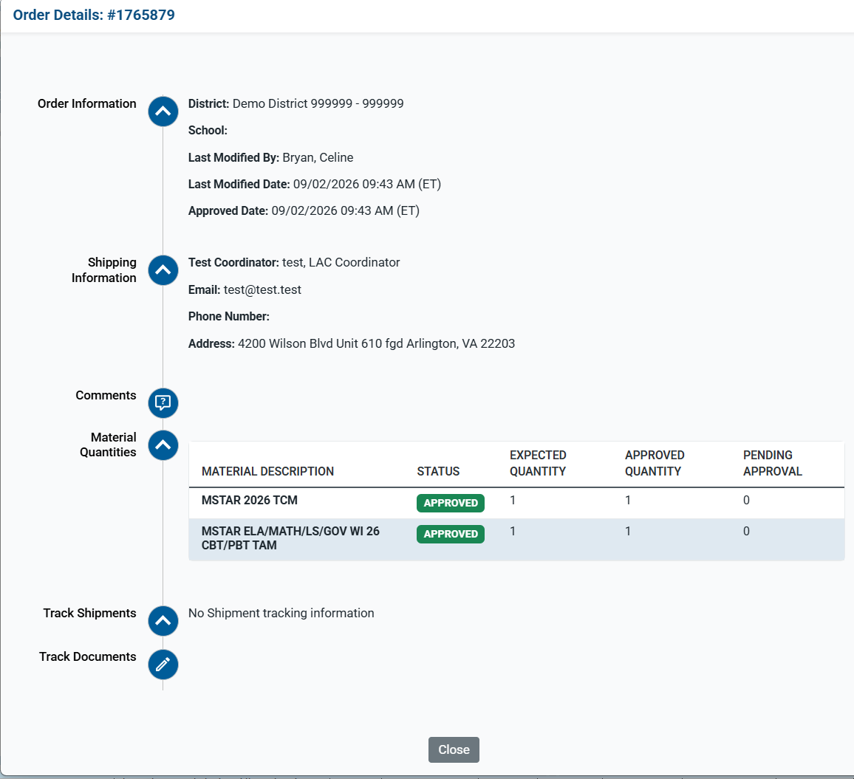
TIDE: Order History
Preparing for Testing
Notes:
Celine You can view a history of the orders that have been placed for your LEA. Select on the Order Number to get more details about the order, including tracking information and any documents related to the order.

Slide 65
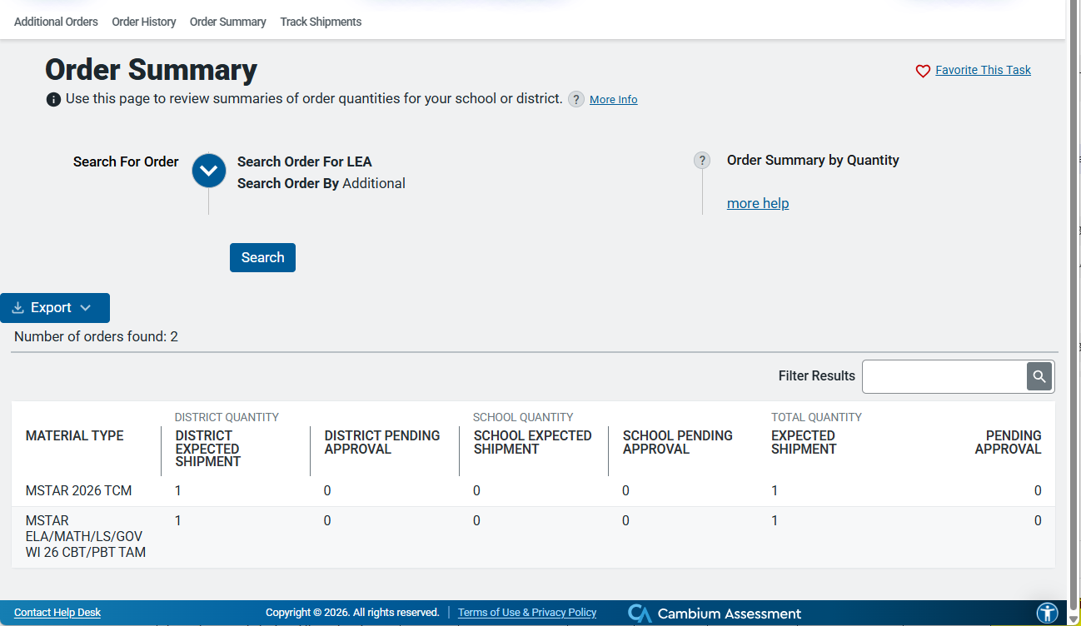
TIDE: Order Summary
Preparing for Testing
Notes:
Celine You may also select Order Summary in order to view the expected quantities for each material type.

Slide 66
UPS Return Materials & Pickup Guidelines
Shipping & Pickup
Packing Return Materials
Outbound return labels are included with Additional Order shipments.
Schedule UPS pickup online and retain the confirmation/tracking number.
Schedule pickups at least 48 hours in advance whenever possible.
Allow 4-7 business days for return transit.
Package all return materials securely in boxes.
Do not combine scorable and nonscorable materials in the same shipment.
UPS Contact Information
Additional Order Windows
Online Pickup:
wwwapps.ups.com/pickup/schedule
Phone: 800-823-7459
Reminder: Schedule pickups at least 48 hours in advance whenever possible.
Notes:
Celine

Slide 67
TIDE: Initial Order Deadlines and Additional Order Windows
Preparing for Testing
Winter EOC Additional Order Window for Paper Materials | 11/23/26 - 1/29/27
Winter EOC Additional Order Window for Return Materials | 1/23/26-1/29/27
Winter 2026 Key Dates: https://mstar.mdassessments.com/resources/training/MCAP%20Winter%202026%20Reporting%20Key%20Dates%20v3%20(1).pdf
Notes:
Celine - On this slide, we will focus on Initial Order Deadlines and Additional Order Windows.
The key points are Winter EOC Additional Order Window for Paper Materials | 11/23/26 - 1/29/27; Winter EOC Additional Order Window for Return Materials | 1/23/26-1/29/27; Preparing for Testing.
Please use the MSTAR Portal as the source for the full schedule and monitor communications for updates.

Slide 68

Accommodations and Accessibility Features
Crosswalk between MSTAR Systems and Maryland Assessment, Accessibility, & Accommodations Manual
Notes:
Celine (entire section) On this slide, we will focus on Accommodations and Accessibility Features.
The key points are Crosswalk between TIDE and TDS and Maryland Assessment, Accessibility, & Accommodations Manual.
The operational takeaway is to verify settings before testing and correct any discrepancy before the student proceeds.

Slide 69
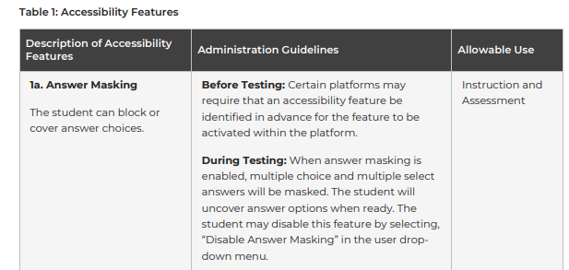
Test Settings and Accommodations
Table 1: Accessibility Features
1a. Answer Masking
1b. Audio Amplification
1c. Bookmark (flag item for review)
1d. Color Contrast (Background/Font Color)
1e. Blank Scratch Paper
1f. Eliminate Answer Choices
1g. General Directions Clarifie1h. General Directions Read Aloud and Repeated as Needed
1i. Highlight Tool
1j. Headphones or Noise Buffers
1k. Line Reader Mask Tool
1l. Magnification/Enlargement Device
1m. Notepad
1n. Pop-up Glossary
1o. Redirect Student
1p. Spell Check or External Spell Check Device
1q. Student Reads Content Aloud to Him or Herself
1r. Text-to-Speech for the Mathematics, Science and Social Studies Assessments
1s. Human Reader or Human Signer for the Mathematics, Science and Social Studies Assessments (Spanish and English)
1t. Writing Tools
1u. Graphic Organizer
1v. Audio Materials
1w. Spanish Version Computer based assessment
1x. Bluetooth Hearing Aids
1y. Electronic Device for Medical Purposes
Notes:
On this slide, we will focus on Table 1: Accessibility Features.
Added the MAAM codes to all settings and tools in TIDE. For example, 1b. Audio Amplification is listed in TIDE as 1b. Audio Amplification.
In the next few slides, we will demonstrate how the Accessibility Features listed in Table 1 of the MAAM are included in TIDE and in TDS.

Slide 70


TDS: Embedded Accessibility Features
1a. Answer Masking
1c. Bookmark (flag item for review)
1f. Eliminate Answer Choices
1i. Highlight Tool
1k. Line Reader Mask Tool
1l. Magnification/Enlargement Device
1m. Notepad
1p. Spell Check or External Spell Check Device
Notes:
There are several accessibility features that are automatically embedded in the Test Delivery System. They are listed in the table above. The screenshots show examples of how they are included in TDS. As you can see, the MAAM codes will not appear in TDS.

Slide 71

TIDE: Selectable Non-Embedded Accessibility Features
1b. Audio Amplification
1e. Blank Scratch Paper
1g. General Directions Clarifie1h. General Directions Read Aloud and Repeated as Needed
1j. Headphones or Noise Buffers
1l. Magnification/Enlargement Device
1o. Redirect Student
1p. Spell Check or External Spell Check Device
1q. Student Reads Content Aloud to Him or Herself
1t. Writing Tools
1u. Graphic Organizer
1v. Audio Materials
1x. Bluetooth Hearing Aids
1y. Electronic Device for Medical Purposes
Notes:
Here is the Test Attributes tab of the Student page. All non-embedded Accessibility features that are listed in Table 1 of the MAAM are included in the Non-Embedded Accessibility Features row for each subject.

Slide 72

TIDE: Selectable Embedded Designated Supports
Notes:
The Embedded Designated Supports section of the Test Attributes tab includes the following Accessibility Features listed in Table 1: Answer Masking, Line Reader Mask Tool, Color Contrast, Streamlined Mode (for Screen Readers) and Pop-Up Glossaries. While both Answer Masking and Line Reader Mask Tool are embedded in TDS, they are listed here as on by default. However, you can turn them off. You can also pre-select the Print or Zoom Size for students in this section.

Slide 73

TIDE: Selectable Language and Text to Speech
Notes:
Under the Presentation Supports and Accommodations section of the tab, you will find drop-downs for Language. All subjects include English Computer Based Assessment and Screen Reader. Mathematics, Science, and Social Studies include Spanish Computer Based Assessment. [1] In the Text-to-Speech section, you will find Text to Speech coded as an Accessibility Feature for Mathematics, Science, and Social Studies.

Slide 74

TIDE: Selectable Human Reader and Human Signer
Notes:
Lastly, Human Reader or Human Signer options are listed for each subject in the Human Reader or Human Signer row. All subjects include English. Mathematics, Science, and Social Studies include Spanish as well.

Slide 75

Test Settings and Accommodations
Table 2: Administration Considerations
2a. Small Group
2b. Time of Day
2c. Separate or Alternate Location
2d. Specified Area or Setting
2e. Adaptive or Specialized Equipment or Furniture
2f. Frequent Breaks
2g. Reduce Distraction to Self
2h. Reduce Distraction to Others
2k. Unique Accommodation
Notes:
The Test Attributes tab also includes all the administration considerations listed in Table 2 of the MAAM.

Slide 76


TIDE: Selectable Non-Embedded Administration Considerations
Notes:
All administration considerations, with the exception of Unique Accommodation, are included in the Non-Embedded Administration Consideration row under Designated Supports (Non-Embedded)on the Test Attributes tab. 2k. Unique Accommodations is listed in the Unique Accommodations and Supports row under Accommodations (Non-Embedded)

Slide 77

Test Settings and Accommodations
Table 3: Presentation Accommodations for Students with Disabilities
3a. Assistive Technology for Presentation
3b. Screen Reader
3d. Hard Copy Braille Edition
3e. Tactile Graphics
3f. Large Print Edition (Available in English or Spanish)
3g. Paper Test Edition (Paper Test) (Available in English and in Spanish)
3h. Closed Captioning Multi-media Passages
3i. Text-to-Speech for ELA/Literacy
3j. ASL Video for ELA
3k. Human Reader/Human Signer for ELA/L
3l. American Sign Language (ASL) Video for Mathematics, Science, and Social Studies
3m. Human Signer for Test Direction
3q. Unique Presentation Accommodations
Notes:
The Test Attributes tab also includes all the administration considerations listed in Table 3 of the MAAM.

Slide 78

TIDE: Selectable Presentation Accommodations
Notes:
Most of the accommodations listed in Table 3 are included in the Presentation Supports and Accommodations section of the Test Attributes tab. The next section, Permissive Mode, is for Students who Require Assistive Technology, including for Presentation. Permissive Mode must be turned on for Assistive Technology to work with the Test Delivery System. In the Text-to-Speech section, 3i. Text-to-Speech for ELA is listed. Not shown here, 3q. Unique Presentation Accommodations, is listed Under the Unique Accommodations and Supports row.

Slide 79

Test Settings and Accommodations
Table 4: Response Accommodations
4a. Assistive Technology for Response
4b. Braille Notetaker
4c. Braille Writer
4d. Mathematics Tools / Calculator on Calculator Sections for Math, Science, and Social Studies
4e. Mathematics Tools / Calculator on non-calculator Sections on Mathematics Assessments
4f. Speech to Text
4g. Human Scribe Response
4h. Human Signer Response
4i. Monitor Test Response
4j. Word Prediction (Embedded)
4k. Answers Recorded in Test Book (for students taking a paper assessment)
4l. Recording Devices
4n. Partner Assisted Scanning
4o. Unique Response Accommodations
Notes:
The Test Attributes tab also includes all the administration considerations listed in Table 4 of the MAAM.

Slide 80

TIDE: Selectable Non-Embedded Response Accommodations
Notes:
Several of the accommodations listed in Table 4 are included in the Accommodations (Non-Embedded) section of the Test Attributes tab. All non-embedded accommodations, with the exception of Unique Response Accommodations are included in the Non-Embedded Response Accommodations row. Unique Response Accommodations are included in the Unique Accommodations and Supports row.

Slide 81

TIDE: Selectable Embedded Response Accommodations
Notes:
The other Response Accommodations listed in Table 4 are included in the Permissive Mode and Embedded Response Accommodations sections of the Test Attributes tab. Permissive Mode needs to be turned on to use any sort of Assistive Technology. Under Embedded Response Accommodations, you will find [1] Speech to Text, Co-Writer Word Prediction, and 100s Number Table and Multiplication Table, both tools listed as part of 4d. And 4e.

Slide 82

Test Settings and Accommodations
Table 5: Timing and Scheduling Accommodations
5a. Extended Time
5b. Unique Timing and Scheduling Accommodation
Notes:
The Test Attributes tab also includes the accommodations listed in Table 5.

Slide 83

TIDE: Selectable Scheduling & Timing Accommodations
Notes:
5a. Extended Time is listed under the Embedded Response Accommodations section and 5b. Unique Timing and Scheduling Accommodations is listed under Unique Accommodations and Supports.

Slide 84

Test Settings and Accommodations
Table 7: Accessibility and Accommodations for Multilingual Learners
1w. Spanish Version Computer based assessment.
7a. Extended Time
7b. Word-to-Word Dictionary/Electronic Translator (English/native language)
7e. General Administration Directions read aloud and repeated in Spanish
7f. General Administration Directions Clarified as Needed in the Student’s Native Language
Notes:
Lastly, all the accessibility features and accommodations listed in Table 7 are also listed in the Test Attributes tab.

Slide 85


TIDE: Selectable Accessibility & Accommodations for ML Learners
Notes:
The Extended Time row under the Embedded Response Accommodations section of the Test Attributes tab includes code 7a. Extended Time. [2] The Accessibility and Accommodations for Multilingual Learners section includes 7b. Word to Word Dictionary/Translator, 7e. General Administration Directions read aloud and repeated in Spanish, and 7f. General Administration Directions Clarified as Needed in the Student’s Native Language.

Slide 86

TIDE: Selectable Accessibility & Accommodations for ML Learners
Notes:
Under the Presentation section of the Test Attributes tab, the Language row includes 1w. Spanish Computer Based Assessment for Mathematics, Science, and Social Studies.

Slide 87
MSTAR: Day of Testing
Users Involved:
LACs
STCs
TAs
Notes:
Suzanne CAI - On this slide, we will focus on MSTAR: Day of Testing.
The key points are Users Involved: LACs, STCs TAs.
With that context, let us move to the next step in the process.

Slide 88
Test Administrator: Day of Testing
Day of Testing
Before Starting a Test Session
  TAM Checklist
  Ensure you have Paper Test Materials, as needed
  Complete the following TIDE Tasks
    Print Test Tickets, if needed
    Confirm Student Test Settings and Tools
    Create Rosters, as needed
Starting a Test Session
  Create an online test session
  Help students launch the TDS Student interface and log in, if needed
Notes:
Suzanne CAI – This slide provides an overview of what the Test Administrator will be responsible for on the day of testing. TAs will have a much more prominent role in testing beginning this year and it is important that they are prepared and knowledgable about the role they will play.
Before – TAM, paper test materials, complete following TIDE tasks – print student test tickets, confirm student test setting and tools including accommodations, and create rosters if needed. As a reminder, rosters are NOT required to test in the TDS, but they are required to be created for downstream score reporting for TA roles, including Teachers who may not have necessarily administered the assessment but is responsible for accessing their scores in the CRS post testing.
TAs will be responsible in creating an online test session. These sessions are created on the fly as students are ready to test and do not need to be scheduled beforehand. TAs will also be responsible for helping students lauch and log into the TDS student interface.
During a test session, TAs will monitor testing while students are actively testing, including walking around the classroom and monitoring student progress in the TA interface.

Slide 89
Test Administrator: Day of Testing
Day of Testing
During a Test Session
  Monitor Testing while students are actively in a test session
    Walk around the classroom
    Monitor student progress in the TA Interface
    Ensure that any testing irregularities have been reporting to the STC for next actionable steps.
Ending a Test Session
  Confirm all students have logged out of the TDS Student Interface when testing time is up
After Testing
  Return all materials to STCs School Test Coordinator (STC)
  Report any final invalidations or testing irregularities to the STC, especially if anything needs to be entered into TIDE by the STC.
Notes:
Suzanne CAI - On this slide, we will continue to focus on the Test Administrator - Day of Testing.
During a test session, TAs will monitor testing while students are actively testing, including walking around the classroom and monitoring student progress in the TA interface.
TAs will end the test session for students when testing is complete, including being sure that students have logged out of the TDS student interface when testing has been completed.
TAs will return all test materials, such as paper test booklets to the STC after testing is complete.

Slide 90
School Test Coordinator: Day of Testing
Day of Testing
Before Testing Begins
  TIDE Tasks
    Ensure students have the appropriate Test Settings and Tools in TIDE
    Ensure Test Assignment Tags are set for students participating in the EOC Assessments
    Provide TAs with Student Test Tickets or advise TAs to print them.
    Ensure TAs have the appropriate paper materials, as needed
During Testing Session
  Provide support to TAs, as needed
  Submit any Resets and Invalidations in TIDE for any testing irregularities reported by TAs
After a Test Session
  Use the reports in Monitoring Test Progress in TIDE to ensure all students are where they need to be at the end of the day
Notes:
Suzanne CAI - On this slide, we will shift our focus to the School Test Coordinator and their Day of Testing responsibilties.
There are several tasks in TIDE that the STC will ensure are completed before testing begins, including ensuring that students have the appropriate test settings and accommodations are set in TIDE. STCs will also ensure that the appropriate assignment tasks are set for students participating in the EOC assessments. This will ensure that if a student is taking Algebra I for example and are in 8th grade, they will get the Algebra I test instead of the Math Grade 8 test.
STCs will also provide TAs will student test tickets or provide instructions to the TA on how to print them in TIDE prior to testing. STCs will also ensure that the TAs have the paper test materials needed prior to testing.
During a testing session the STC will support TAs as needed, including submitting any resets or invalidations into TIDE as reported by the TA in a timely manner.
After a test session the STC will monitor test progress in TIDE to ensure all tests that they expect to be completed have in fact been completed or tracked if a make up test needs to occur if a student is out for an illness, for example.

Slide 91
Local Accountability Coordinator: Day of Testing
Day of Testing
Before Testing Begins
  TIDE Tasks
    Work with the STC to ensure students have the appropriate Test Settings and Tools in TIDE
    Work with the STC to ensure Test Assignment Tags are set for students participating in the EOC Assessments
  Ensure TAs have the appropriate paper materials, as needed
During Testing Session
  Provide support to STCs and TAs, as needed
  Approve any Resets and Invalidations in TIDE for any testing irregularities reported by TAs
After a Test Session
  Use the reports in Monitoring Test Progress in TIDE to ensure all students are where they need to be at the end of the day
  Work with STCs to discuss any questions about student test statuses at the end of the day, including if a make up day needs to be established for testing.
Notes:
Suzanne CAI - On this slide, we will shift our focus to the responsibilities of the LAC on the Day of Testing
Before testing begins, LACs will work with STCs to ensure that students have the appropriate test setting and accommodations enabled in TIDE. LACs will support to apply assignment codes for EOC tests if applicable. LACs will also work with the STCs to ensure that students who need paper materials have them available before the test session begins, in a secure location prior to testing.
During testing, LACs will support STCs and TAs as needed. LACs will also be available during testing to review and approve any resets, irregularities or other testing incidents in TIDE in a timely manner to support school level testing personnel.
After a testing session, LACs will review the Monitoring Test Progress feature in TIDE to ensure all students have tested and are where they should be at the end of the day. LACs will work with the STCs if they have any particular questions about student progress post testing.

Slide 92
Test Delivery System: Administering Tests
Users Involved:
TAs
Notes:
Suzanne CAI - On this slide, we will focus on Test Delivery System: Administering Tests.

Slide 93
Test Delivery System
  NEW: Test Delivery System Test Design
  Tests will not be strictly timed beginning in SY26-27. Students will not need to be moved to a new section if they do not finish on time. They will resume testing where they left off.
  The different 'parts' of the test are called 'stages'
  All stages will be non-permeable which means that the students will not be able to go back once they leave a stage. There will be a review screen that allows them to go back and review before leaving the stage.
Notes:
Suzanne CAI – There are some important updates to the online TDS test design since our last training in July.
CAI will read the entire slide.

Slide 94
  NEW: Test Delivery System Test Design, Continued
  TAs will approve students into the next stage of the test in TDS for all tests.
  Test Administrators will be able to monitor the time spent in each section on the TA interface while the student is actively testing.
  Students must respond to all items on a test page in TDS to move forward. Items cannot be skipped. A message will display in TDS if the student still needs to respond to a test question, to alert the student. This is true for all adaptive, multi-stage adaptive, and linear fixed form tests.
Notes:
Suzanne CAI will read the entire slide.

Slide 95
  MSDE Best Practices on Timing and Test Scheduling
  TDS Testing Guidance Student Absences and Rescheduling
    Test Sessions do not have to be scheduled in advance by TAs or STCs in the new TDS.
    Students can be added on the fly and immediately access a test session as soon as they receive the session ID and the student is in Launchpad/TIDE.
Notes:
MSDE

Slide 96
Assessment Timing –
Time Blocks
40 Minutes
40 Minutes
40 Minutes
40 Minutes
Student 1
Section 1
Section 2
Section 3
Section 4
Student 2
Section 1
Section 2
Section 3
Section 4
Student 3
Section 1
Section 2
Section 3
Section 4
Student 4
Section 1
Section 2
Section 3
Section 4
Student 5
Section 1
Section 2
Section 3
Notes:
MSDE

Slide 97
Student 5 Experience
Time Blocks
40 Minutes
40 Minutes
40 Minutes
40 Minutes
Student 5
Section 1
Section 2
Section 3
Time Block 1
  Start – Student logs in for Section 1
  End - Student logs out with Section 1 questions incomplete
Time Block 2
  Start – Student resumes in Section 1 and can work on remaining questions
  End – Student logs out with Section 1 questions incomplete
Time Block 3
  Start – Student resumes in Section 1 and can work on remaining questions
  TA moves student to Section 2 when Section 1 is submitted by the student
  End – Student logs out with Section 2 questions incomplete
Time Block 4
  Start – Student resumes in Section 2 and can work on remaining questions
  TA moves student to Section 3 when Section 2 is submitted by the student
  End – Student logs out with a portion of Section 3 and all of Section 4 incomplete. Assessment is marked complete for scoring.
Notes:
MSDE

Slide 98

TDS: Test Administrator (TA) Interface
Test Delivery System (TDS) – TA Interface
Notes:
Oliver CAI - Now that we have covered some test design updates lets review the TA interface site in TDS and responsibilities for TAs on testing day.
This is a view of the TA interface that a TA will see when they log in and before they start a test session for students.

Slide 99
TDS: Starting a Test Session (TA Interface)
Test Delivery System (TDS) – TA Interface
Log into Launchpad. Then the user will click on the TA Interface tile through LaunchPad.
On the TA Interface Dashboard, click Start a New Session Now.
Notes:
Oliver CAI - This slide illustrates how a TA will start a test session. This will occur after a TA logs into Launchpad which will provide a link to the TA Interface tile in TDS. TAs will click on this tile. On the TA interface, they will see a message to click Start a Session Now.

Slide 100


TDS: Selecting Tests to Add to Session (TA Interface)
Test Delivery System (TDS) – TA Interface
Select the test you want to add to the session and administer.
The test will show up on the right side of the window.
Click "Start Practice Session" to open the session with the selected tests.
Notes:
Oliver CAI - The TA will select the test or tests you want to administer, with the available tests showing up on the right side of the TDS window. Click "Start Practice Session" to start the session with the selected tests.

Slide 101


TDS: Student Login (Student Interface)
Test Delivery System (TDS) – Student Interface
Notes:
Oliver CAI – Now let's switch and look at the view from the Student TDS application site. On this slide, the student will be presented with a log in screen. The student will enter their last name and SASID.
Next, they will see a screen that says 'Is This You' which allows the student to verify their information before proceeding.

Slide 102


TDS: Session ID (TA and Student Interface View)
Test Delivery System (TDS) – TA and Student Interface
Notes:
Oliver CAI – The Session ID on the left represents what the TA will provide the student from their device, where they created a test session.
The Session ID will be entered by the student in the Login Session screen on the right side of this slide.

Slide 103


TDS: Selecting a Test and Waiting for Approval (Student Interface)
Test Delivery System (TDS) – Student Interface
Notes:
Oliver CAI – Remember from a previous slide, that the TA has already selected the tests that are available in the testing session. The student will select the test that they are going to take and will then wait for the TA to approve them into the Session. The image on the right represents what the students will see as they wait for TA approval.

Slide 104

TDS: Approving Students to Enter Test Session (TA Interface)
Test Delivery System (TDS) – TA Interface
Notes:
Oliver CAI – The TA will get a notification in red,

Slide 105

TDS: Reviewing Test Settings and Accommodations (TA Interface)
Test Delivery System (TDS) – TA Interface
Notes:
Oliver CAI - On this slide, we will focus on Reviewing Test Settings and Accommodations.
The key points are Test Delivery System (TDS) - TA Interface.
The operational takeaway is to verify settings before testing and correct any discrepancy before the student proceeds.

Slide 106

TDS: Entering the Test (Student Interface)
Test Delivery System (TDS) – Student Interface
Notes:
Oliver CAI - Student will be entering the test. On this slide, we will focus on Entering the Test.
The key points are Test Delivery System (TDS) - Student Interface.
With that context, let us move to the next step in the process.

Slide 107

TDS: Monitoring the Test Session (TA Interface)
Test Delivery System (TDS) – TA Interface
Notes:
Oliver CAI - On this slide, we will focus on Monitoring the Test Session.
The key points are Test Delivery System (TDS) - TA Interface.
With that context, let us move to the next step in the process.

Slide 108

TDS: Monitoring the Test Session (TA Interface)
Test Delivery System (TDS) – TA Interface
Notes:
Oliver CAI - On this slide, we will focus on Monitoring the Test Session.
The key points are Test Delivery System (TDS) - TA Interface.
With that context, let us move to the next step in the process.

Slide 109

TDS: Possible Test Statuses (TA Interface)
Test Delivery System (TDS) – TA Interface
Notes:
Oliver - On this slide, we will focus on Possible Test Statuses.
The key points are Test Delivery System (TDS) - TA Interface.
With that context, let us move to the next step in the process.

Slide 110


TDS: Pausing and Ending Test Sessions (TA Interface)
Test Delivery System (TDS) – TA Interface
Notes
Sessions cannot be renewed and TAs must create a new session to continue testing.
TDS will automatically log out students after 20 minutes of inactivity and logs users out of the TAs after 30 minutes of inactivity.
Logging out of the TA Interface due to inactivity automatically stops the test session and pauses student tests.
Notes:
Oliver CAI - On this slide, we will focus on Pausing and Ending Test Sessions.
Read Notes section in full

Slide 111
TDS Demonstration: Student and TA Interface
Test Delivery System
Demonstration
Notes:
Oliver CAI – We will now show a demonstration in our testing site of what we previously discussed, including how it will look when a TA begins a test session and a student logs in and is approved for testing in this test session.

Slide 112
TIDE: During Testing
Users Involved:
LACs
STCs
TAs
Notes:
Celine – Now lets switch back to TIDE and review what LACs, STCs, and TAs will be responsible for monitoring and accessing during the testing window. As a reminder, we have gone over TIDE pre testing activities including checking accommodations and test settings for students and the TA has begun test administration and the testing window is proceeding.

Slide 113

TIDE: During Testing
During Test Administration
Ensure that any remaining test tickets have been provided to STCs and ensure all paper materials have a student pre-ID label
Resets and Invalidations, including Report, enter and approve testing irregularities based on the user role.
Monitoring Test Progress for groups of students based on user role
Notes:
Celine –

Slide 114
TIDE: During Test Administration Tasks
During Test Administration
During Testing TIDE Tasks | Local Accountability Coordinator (LAC) | School Test Coordinator (STC) | Test Administrator (TA)
Printing Test Tickets and PreID Labels, as needed | ✓ | ✓ | ✓
Monitoring Test Progress | ✓ | ✓
Creating Resets and Invalidations |  | ✓✓ | ✓
Approving Resets and Invalidations | ✓
Notes:
Celine – This slide represents the different tasks that LACs, STCs and TAs will be involved with during the testing window. This includes printing test tickets, monitoring student progress, creating resets and invalidations and approving resets and invalidations.
One particular note we wanted to point out on this slide is that with the increased responsibility that TAs now have during test administration, they will be the ones that will notify STCs if there is a need for a test reset or invalidation. The STC will submit the appeal irregularity in TIDE. The LAC will review and approve the irregularity.

Slide 115




TIDE: Printing Test Access Materials
TIDE Before Test Administration
Notes:
Celine – On this slide, we will focus on Test Tickets, QR Codes, & Pre-ID Labels. Right before testing, users will have to print Test Access Materials, including: PreID Labels for paper testers, Test Tickets, and QR Codes. LACs should determine which role will be responsible for these materials: LACs, STCs, or TAs.
A test ticket is a hard-copy form that includes information a student needs to log in to a test. You may also print out QR Codes as a means for students to access tests. From this task group, you can also print out PreID labels. TIDE generates the test tickets, PreID Labels, and QR Codes as PDF files that you download with your browser.

Slide 116

LAC, STC, and/or TA: Print from Student List
TIDE Before Test Administration
Notes:
Celine – To print test tickets, or other materials, from a student list, select Print from Student List from the Print Test Tickets and Labels task group. Complete the fields under the Search Students section. The fields marked with an asterisk are mandatory. To further refine your search results, select additional search fields in the Advanced Search section. Select Search and View Results from the pop-up.

Slide 117

LAC, STC, and/or TA: Print from Student List
TIDE: Before Test Administration
All
Students
Specific
Students
Notes:
Celine – Next, select the students for whom you want to print test tickets. To print test tickets for specific students, mark the checkboxes for the students you want to print. To print for all students on the page, mark the checkbox at the top of the table. To print for all retrieved students, no additional action is necessary. This option is available by default.
Expand the Print dropdown and select the Test Tickets option from the menu. A test ticket layout screen will appear. Choose a test ticket layout and print option and select Print. A PDF of the test tickets will be downloaded.

Slide 118

LAC, STC, and/or TA: Print from Roster List
TIDE: Before Test Administration
Notes:
Celine – To print test tickets from a roster list, select Print from Roster List from the Print Test Tickets card. Complete the fields under the Search for Rosters to Edit section. The fields marked with an asterisk are mandatory. Select Search to display your results.

Slide 119


LAC, STC, and/or TA: Print Test Tickets
TIDE: Before Test Administration
Notes:
Celine – Next, select the roster for which you want to print test tickets. To print test tickets for specific rosters, mark the checkboxes for the rosters you want to print. To print for all rosters on the page, mark the checkbox at the top of the table.
Expand the Print dropdown and select the Test Tickets option from the menu. A test ticket layout screen will appear. Choose a test ticket layout and print option and select Print. A PDF of the test tickets will be downloaded.

Slide 120


LAC and STC: Plan and Manage Testing: Basic Search
TIDE: During Test Administration
Notes:
Celine – Plan and Manage Testing Provides real-time, student-level and opportunity-level details about participation and non-participation. Allows filtering by student attributes, session ID, opportunity number, test status, and other fields.
On this slide, we will focus on Plan and Manage Testing: Basic Search.

Slide 121



LAC and STC: Plan and Manage Testing: Advanced Search
TIDE: During Test Administration
Notes:
Celine – This screen displays the Advanced Search functionality in TIDE, used by all users LACs, STCs and TAs to locate specific students and filter reporting data.
Along with the Basic Search there is also the Advanced Search, highlighted on this slide as well as a Favorites search that will allow users to ability to Favorite particular searches that they use often.
The left panel shows the Student Group (LEA and School) and specific student filters that can be applied including Enrolled Grade and Birth Date.
There are also specific student attributes that can be searched on including First Name, Last Name and SASID.
The image in the top right shows how particular tests can be searched on, such as the MCAP Winter EOCs. Below that you can search by student test progress criteria including test progress, statuses, Session ID, TA name, and a single or mutliple student SASID search.

Slide 122



STC and TA: Identify Students to Complete Testing
TIDE: During Test Administration
Which students have not yet tested?​
Which students have paused tests?​
Did all students in a test session submit their tests?
Notes:
Celine – This slide allows STCs and TAs to focus in on particular search criteria. This includes for example, identifying students who have or have not completed a test in the selected administration.
Students with paused tests can also be searched on to determine next steps that need to occur so that they can resume and complete testing.
STCs can also review Session ID and TA names to ensure that all students have successfully submitted their tests.

Slide 123

LAC and STC: Monitoring Test Progress
During Test Administration
Notes:
Celine – This is an example of a report from Monitoring Test Progress. Basic Search and Advanced Search provide the same report template.

Slide 124


LAC and STC: Participation Search by SASID
TIDE: During Test Administration
Notes:
Celine – You may also Search by SASID to create a Plan and Manage Testing Report.

Slide 125

LAC and STC: Test Completion Rates
TIDE: During Test Administration
Notes:
Celine – Test Completion Rates are updated overnight and provide a cumulative count at the LEA and school level.

Slide 126

LAC and STC: Test Session Status Report
TIDE: During Test Administration
*Sample Image
Notes:
Celine – On this slide, we will focus on Test Session Status Report.
This report summarizes active test sessions scheduled or running on the current day, including school, session ID, proctor name, and status summaries.

Slide 127

LAC and STC: Test Status Code Report
TIDE: During Test Administration
Notes:
Celine – On this slide, we will focus on Test Status Code Report.
This report is designed for district and school roles to view test status and opportunity data along with non-participation codes or reasons why a student has not tested.

Slide 128

LACs and STCs: Resets and Invalidations
TIDE: During Test Administration
Possible Resets and Invalidations
Reset a Test
Invalidate a Test
Re-open a test
Restore a test that was reset
Grade Period Extension
Reopen test section
Notes:
Celine – – STCs are responsible for entering all resets, invalidations and other test irregularities listed above in TIDE, as they are reported to them by TAs. LACs will be responsible for reviewing and approving these during and after testing.
The next slide will discuss these resets and invalidations in more detail.
In the Test Information Distribution Engine (TIDE) and Test Delivery System (TDS), Appeals (or Invalidation Requests) are administrative actions used to interrupt or modify the standard flow of a student's test opportunity due to testing disruptions, accommodations errors, or improprieties.

Slide 129
Types of Resets and Invalidations
TIDE: During Test Administration
  Invalidation – Very serious. A student loses the opportunity to test and receive a score on their assessment
    Examples:
      A student uses their cell phone to look up answers to the assessment.
      A TA coaches students in the testing session on how to answer the assessment to get a higher score.
  Reset- Resets a test opportunity so that the student can start a new testopportunity.
    Example: A student started testing with the wrong accommodations.
Re-open a test – A student needs to complete their test opportunity and the test session has ended.
    Example: A student is testing and loses power. The testing session closes before the student is able to complete the test.
Notes:
Celine – In the next few slides we will go over the different types of resets and invalidations.
1. Invalidate a Test
Definition: Eliminates a test opportunity by declaring it invalid.
System Effect: The student's test opportunity and responses remain saved in the database, but the test status is marked as Invalidated. The student cannot resume testing, retake that test opportunity, or receive a reportable score for it.
Common Use Case: Used in situations such as severe test improprieties (e.g., cheating, unauthorized device usage) or major testing environment disruptions where the test results cannot be counted.
2. Reset a Test
Definition: Completely deletes/resets a student's test opportunity and clears all associated item responses.
System Effect: Removes all previously recorded student responses for that attempt from downstream systems and returns the student to an untested state for that opportunity. When the student logs back in, they restart the test from question 1 as if taking it for the first time (generating a new Result ID).
Common Use Case: Used when a student took a test under incorrect settings or missing required accommodations (e.g., Text-to-Speech was accidentally left off), significantly impacting their test attempt.
3. Re-open a Test
Definition: Changes the status of an expired, submitted, or invalidated test opportunity back to active/paused so the student can resume testing.
System Effect: Re-activates the test opportunity and allows the student to log back into the Test Delivery System (TDS) and resume where they left off. Depending on state configuration and whether it is paired with a Grace Period Extension, the student can access unanswered or unsubmitted items in their active segment.
Common Use Case: Used when a student's test accidentally expired at the end of a testing window, was submitted prematurely, or needs to be resumed after an approved appeal.
4. Restore a Test That Was Reset
Definition: Reverses/undoes a previous Reset appeal.
System Effect: Restores the student's original test opportunity and brings back all item responses and test state that existed prior to the reset being processed.
Common Use Case: Used if a test was reset by mistake or if a district/school determines that the original test attempt should be retained and scored instead of a restart.
5. Grace Period Extension (GPE)
(Note: Commonly referenced in TIDE as Grace Period Extension / GPE)
Definition: Overrides standard test pause rules to allow a student to review and edit questions in their current/last active test segment after a pause.
System Effect: When a student pauses a test for longer than the standard grace period (e.g., 20+ minutes), TDS normally locks previously viewed items. A Grace Period Extension unlocks those items in the active segment, allowing the student to navigate back and edit or complete their responses.
Common Use Case: Used when a test session is unexpectedly interrupted (e.g., building power outage, fire drill, network drop) and the student needs to resume testing without losing the ability to access previously viewed items in that segment.
6. Reopen Test Segment (Reopen Prior Test Segment)
Definition: Grants permission for a student to re-enter a specific test segment that was previously completed and exited.
System Effect: Allows the student to navigate back into an earlier, impermeable segment boundary that had already been submitted, making unanswered or editable items in that specific segment accessible again (subject to adaptive test routing rules).
Common Use Case: Used when a student was inadvertently advanced into a new segment before completing all items in a prior segment due to a technical error or miscommunication during test administration.

Slide 130
Types of Resets and Invalidations, continued
During Test Administration
  Restore a test that was reset – A student test that was reset is reversed so the opportunity becomes available again.
    Example: A school loses power and instead of requesting a reopen request, the LAC submits a reset a test request.
  Grade Period Extension – A student is allowed back into a test section even though the session has ended.
    Example: A student is testing in Section 1 and becomes ill and leaves for the day. The Grace Period Extension will allow them to enter back into the section to complete the section.
  Reopen test segment – will reopen a test section that has been completed in TDS.
    Example: A student is reviewing their responses and accidently submits the test before they are done reviewing items they have marked for review in a section.
Notes:
Celine –
4. Restore a Test That Was Reset
Definition: Reverses/undoes a previous Reset appeal.
System Effect: Restores the student's original test opportunity and brings back all item responses and test state that existed prior to the reset being processed.
Common Use Case: Used if a test was reset by mistake or if a district/school determines that the original test attempt should be retained and scored instead of a restart.
5. Grace Period Extension (GPE)
(Note: Commonly referenced in TIDE as Grace Period Extension / GPE)
Definition: Overrides standard test pause rules to allow a student to review and edit questions in their current/last active test segment after a pause.
System Effect: When a student pauses a test for longer than the standard grace period (e.g., 20+ minutes), TDS normally locks previously viewed items. A Grace Period Extension unlocks those items in the active segment, allowing the student to navigate back and edit or complete their responses.
Common Use Case: Used when a test session is unexpectedly interrupted (e.g., building power outage, fire drill, network drop) and the student needs to resume testing without losing the ability to access previously viewed items in that segment.
6. Reopen Test Segment (Reopen Prior Test Segment)
Definition: Grants permission for a student to re-enter a specific test segment that was previously completed and exited.
System Effect: Allows the student to navigate back into an earlier, impermeable segment boundary that had already been submitted, making unanswered or editable items in that specific segment accessible again (subject to adaptive test routing rules).
Common Use Case: Used when a student was inadvertently advanced into a new segment before completing all items in a prior segment due to a technical error or miscommunication during test administration.

Slide 131


STC: Create Resets and Invalidations
During Test Administration
Notes:
Celine – – This slide provides the feature that STCs will use to set a reset or invalidation. These irregularities can be searched on by Result ID or Session ID as well.

Slide 132

LAC: View and Approve Resets and Invalidations
During Test Administration
Notes:
Celine – LACs will need to regularly review and approved pending testing irregularities throughout the test window, as they are reported to STCs and submitted by STCs into TIDE. This slide provides a way to quickly search by various criteria including request date or school number. If there is a particular irregularity (case) that the LAC is tracking they can also search by Case.

Slide 133

LAC: View and Approve Reset and Invalidations Results
During Test Administration
Notes:
Celine -
This view allows LACS the ability to review, process, and manage submitted appeal requests — specifically Invalidation and Reset appeals — for students within their organization.
This screen is the central hub for approving pending test invalidation and reset appeals at the LAC level. The Process button is the critical action that officially applies the appeal outcome to the student's test record in the system. You may also export the current results grid to a file (e.g., CSV/Excel) for offline review or record-keeping
Sample Records Displayed
All visible records show Invalidate a test requests submitted on 10/14/2022 – 10/17/2022 with the appeal reason of Student Test Irregularity. Two records are currently checked/selected (blue checkbox) and are in Retracted status, while one record shows a Processed status (with a second red arrow callout pointing to it).

Slide 134
TIDE: After Testing
Users Involved:
LACs
STCs
Notes:
Celine On this slide, we will focus on TIDE: After Testing.
The Users Involved: LACs STCs.

Slide 135

STC: Resolving Paper-Pencil Discrepancies and Data Cleanup
After Testing
Notes:
Celine – This slide represents the After Testing section of TIDE
Data Cleanup is the parent category containing two sub-topics:
Reason Not Assessed (RNA) — entering and managing non-participation codes for students who did not complete testing.
Discrepancy Resolution — resolving discrepancies between paper-pencil test records and system data (currently selected/highlighted as an active link).

Slide 136
Discrepancy Resolution Types
After Testing
Discrepancy Resolution Type | Definition | Possible Cause(s)
Student Not Found | Identifying information on a paper answer document not found in LaunchPad/TIDE | SASID missing from answer document SASID not present in LaunchPad/TIDE The combination of the SASID, First Name, Last Name does not match the combination found in LaunchPad/TIDE
Not Eligible Test | Student submits an answer document for which they are not eligible. | A student accidentally receives A student submits an incorrect answer document.
Duplicate | TIDE detects two or more answer documents were submitted by the same student. | Student submitted an online test and later submitted a paper test. Student inadvertently submitted a test under another student’s name.
Notes:
Celine – Read entire slide

Slide 137
Discrepancy Resolution Types
After Testing
Discrepancy Resolution Type | Definition | Possible Cause(s)
Untested Students | TIDE detects that an answer document was submitted for a student with a Reason Not Assessed (RNA) code. | A student who is marked with an RNA code submits an answer document.
Non-Matching School | A student submits an answer document while enrolled in one school, but LaunchPad/TIDE’s records indicate that the student was enrolled in another school at the time of the test. | A student moved from School A to School B in the middle of the school year, but LaunchPad was not updated to reflect that move. The student then submitted a test while in School B.
Notes:
Celine – Read entire slide

Slide 138

Reason Not Assessed
After Testing
RNA Code | Disables Testing?
Medical Emergency | No
Incorrect Accommodation/ Accessibility Feature Applied | No
Other | No
Cheating/Using Unauthorized Electronic Device | Yes
Notes:
Celine As indicated on this slide, you can input a Reason Not Assessed Code for each test. The chart to the right of the image includes the various available Reason Not Assessed codes. [Read Options]. Only Cheating/Using Unauthorized Electronic Device blocks testing through the system.

Slide 139
Reporting: After Testing
Users Involved:
LACs
DRAs
STCs
TAs
RAs
Notes:
Suzanne - On this slide, we will focus on Reporting: After Testing.
The users involved in reporting are LACs, STCs, TAs, DRAs, and RAs. Reporting access decisions are made at the local level for Maryland. The Reporting systems are set up to provide access to LACs at the district/LEA level, STCs will have school level access, and TAs will have access to students for whom students are assigned to them via rosters in TIDE. As a reminder from earlier in the presentation, DRAs are district level reporting only rules and RAs are school level reporting roles that users can have who mainly are interested in viewing reports in the Reporting system, versus access to other systems like TIDE or TDS. Also, please remember that users can have multiple roles associated to them in Launchpad/TIDE.

Slide 140
Centralized Reporting System (CRS)
Reporting
For SY26-27, both legacy MCAP assessments and new MSTAR assessment score reports will deploy in the Centralized Reporting System (CRS)
MCAP Assessments – Traditional reporting timelines
MCAP ELA 10
MCAP Algebra 1
MCAP Algebra 2
MCAP Geometry
MCAP LS MISA
MCAP American Government
MCAP Science Grade 6 and 8
MCAP Social Studies Grade 8
MSTAR Assessments – Scores will be released post Standard Setting in summer 2027
MSTAR ELA G3-G8
MSTAR Math G3-G8
Notes:
Suzanne – In SY26-27, the MCAP and new MSTAR assessments will deploy student score results in CRS. The Winter EOC, Spring EOC, Summer EOC, Science Grade 6 and 8, and Social Studies grade 8 assessments will deploy on a traditional reporting schedule in comparison to previous years.
The MSTAR ELA G3-G8 assessments will have their scores held until after Standard Setting activities in summer 2027.

Slide 141


CRS: Online Home Page
Reporting
Notes:
Suzanne – This is a mockup of the dashboard that will appear for the Winter EOC assessments in the CRS. Note that the system user interface will be labeled MSTAR but the Winter EOC assessments and other legacy assessments mentioned on the previous slide are still considered legacy MCAP assessments. This slide represents how this will look in CRS for SY26-27. Note that MSTAR assessments will be separated from the MCAP assessments as you can see in this slide of the CRS Home Page. In SY27-28, all assessments will transition to MSTAR.
CRS provides many opportunities to access student data, either individually or at the school or LEA level. Users can search for a single student by entering their SASID in the 'Looking for a specific student' search box.
There are Features and Tools available on the right side of the screen in CRS. This includes an option to change the reporting time period in CRS. A School Test Coordinator might want to view how there new 4th grade students performed on their assessments last year as 3rd grade students. By changing the reporting time period, they would be able to see the students previous years score results.
The download and print option allows users to print student score reports (ISRs) or student data files with score information. ISRs can be printed by bulk for quick distribution after the close of the test administration. The student data file allows users to be able to access a CSV file that can be filtered and sorted to provide access to relevant data for multiple students associated to the user.
Finally, as mentioned previously rosters are required to assign TA users access to view their student score results. Rosters can be added, uploaded or viewed in CRS as you can see on the right side of this slide.

Slide 142


CRS: MCAP Winter EOC Dashboard
Reporting
Notes:
Suzanne – This slide represents a mockup of the Winter EOC dashboard for LEA and school users. Note that only students associated with users based on their permissions will be available to view in the system. This dashboard will show student performance percentages.
There are some additional options on the right of this view that provide additional features and tools for users.
The reporting time period can be changed. This feature is helpful because it will allow users to see how their students performed on tests in the past. For example, a STC might be interested in how their new grade 4 students performed in grade 3 the previous year. By changing this reporting time period, the user will be able to access this data for instructional planning purposes.
There are also options to download student score results, including a data file of score results and PDFs of student score reports that can be downloaded in a bulk download.
There are also options to add, create and view rosters in CRS. Rosters are required for TAs to be able to see student score results for their students.

Slide 143

CRS: MCAP Winter EOC – District Performance on a Test
Reporting
Notes:
Suzanne – This slide represents LEA/district performance overall on the test for schools.
This slide provides an overview of the School Performance on Test page.
The table is organized into two primary sections:
Total assessment performance (as indicated by the blue banner) displays overall metrics for each row including student count, test completion rate, average scale score, performance distribution (red, orange, green, blue) and percent proficient at each school. The information available will be student count, average scale score, performance distribution, percent proficient and reporting category scores. The reporting category accordians on the screen will open up to display student score information.

Slide 144

CRS: District Performance on Test – Reporting Categories
Reporting
Notes:
Suzanne – This slide provides a visual of how the reporting category information will show in CRS when the accordians, as seen on the previous slide are opened.
Specific performance breakdown for the Reading category is shown:
Average scale score – category scale score average
Performance – 2 level performance distribution chart (red versus green) displaying counts and percentages
Item performance distribution chart provides item performance metrics.

Slide 145

CRS: MCAP Winter EOC – Student Result Generator
Reporting
Notes:
CAI – This page shows what it looks like if a user selects 'download and print' from the CRS dashboard. They will select the test reason (administration), assessments, and students that the user is interested in printing. Score reports are available in English and Spanish.

Slide 146


CRS: Individual Score Report (ISR) – MCAP Winter EOC
Reporting
Notes:
Suzanne – As we have mentioned throughout this presentation, some tests, such as the Winter EOC tests will not move to the new MSTAR test design until SY27-28. Although CRS will be new and there will be new features and reporting data available in this platform, the MCAP individual score reports will stay very similar to previous score reports. This slide represents a mockup of the ISR for the SY26-27 MCAP ELA G10 Winter EOC test. As you can see, the report looks very similar to past reports for this assessment. This is intentional as the EOC report test design and score report presentations will not be updated until next school year.

Slide 147
The New MSTAR Customer Support
Notes:
Sandy - On this slide, we will focus on The New MSTAR Customer Support.
When requesting support, provide enough detail for efficient routing while following student data and test security requirements.

Slide 148


New MSTAR Technology Readiness
Diagnostic Readiness Tool
    Available through the TDS Practice Test Site
    Empower technology coordinators to prepare their computers for testing and determine if they have enough Internet bandwidth
    Additional diagnostic checks include running multimedia checks on audio, video and text-to-speech)
Practice Tests
  Multiple online practice tests for educators and students to train on
Tool Tips
  On-screen tips that explains the different tools and accessibility features available in the platform.
Item Tutorials
  Short videos embedded in most items that demonstrates how a student would interact with the item on practice tests and summative tests.
Infrastructure Trial Day
  Districts and schools can take practice tests on a scheduled day to ensure system capacity is sufficient for heavy testing days
Notes:
Sandy 0 On this slide, we will focus on New MSTAR Technology Readiness.
The key points are Diagnostic Readiness Tool Available through the Practice Test Site Empower technology coordinators to prepare their computers for testing and determine if they have enough Internet bandwidth Additional diagnostic checks include running multimedia checks on.
With that context, let us move to the next step in the process.

Slide 149

New MSTAR Portal
Customer Support
https://mstar.mdassessments.
Notes:
Sandy - On this slide, we will focus on New MSTAR Portal.
The key points are Customer Support.
With that context, let us move to the next step in the process.

Slide 150


Learning Management System (LMS)
Customer Support
Notes:
Sandy - Course catalog organized by platform: LaunchPad, TIDE, TDS, CRS, Family Portal and Hotline Direct (exception this is a role)
Self-paced training courses to complete before statewide administration

Slide 151


New MSTAR Customer Support
Customer Support
Contact Customer Support via Phone, Email, or Chat in MSTAR Portal.
Notes:
Sandy - On this slide, we will focus on New MSTAR Customer Support.
The key points are Contact Customer Support via Phone, email, or Live Agent in MSTAR Portal; Customer Support.
When requesting support, provide enough detail for efficient routing while following student data and test security requirements.

Slide 152

New MSTASR Service Center
Customer Support
Notes:
Sandy - On this slide, we will focus on New MSTASR Service Center.
The key points are Customer Support.
When requesting support, provide enough detail for efficient routing while following student data and test security requirements.

Slide 153
Customer Support Reminders
Customer Support
When reaching out to Customer Support always be prepared to provide the following information.
LAC/STC Name
LAC/STC Email/Phone Number
LEA/School Name
Content Area/Assessment Name
Question/Inquiry
Description:
  SASID, Roster name, Admin, Grade (it is ok to provide SASID's to the help desk)
  Device Type, Platform (Chrome, IOS), administration information
Notes:
Sandy - On this slide, we will focus on Customer Support Reminders.
The key points are When reaching out to Customer Support always be prepared to provide the following information. LAC/STC Name LAC/STC Email/Phone Number LEA/School Name Content Area/Assessment Name Question/Inquiry Description: SASID, Roster name, Admin, Grade (it is ok to; Customer Support.
When requesting support, provide enough detail for efficient routing while following student data and test security requirements.

Slide 154
Examples of Tier 1 calls
Customer Support
Errors with file imports in LaunchPad.
Placing Additional Orders for materials in TIDE.
TDS sign in issues-Incorrect State Program was selected, or a wrong Session ID was used.
Students had a paper form instead of an online form assigned so they were unable to sign into their online test until that was corrected.
Notes:
Sandy - On this slide, we will focus on Examples of Tier 1 calls.
The key points are Errors with file imports in LaunchPad. Placing Additional Orders for materials in TIDE. TDS sign in issues-Incorrect State Program was selected, or a wrong Session ID was used. Students had a paper form instead of an online form assigned so they were unable; Customer Support.
With that context, let us move to the next step in the process.

Slide 155
Customer Support Example of Tier 2
– TIDE, TDS, CRS
Customer Support
Reach out to the Help Desk for support on TIDE, TDS, CRS
Please provide the Help Desk with a detailed description of the problem, as well as the following:
TA's name.
If the issue pertains to a student, provide the student's SASID and associated LEA or school. Do not provide the student's name.
If the issue pertains to a TIDE user, provide the user's full name and email address.
Any error messages and codes that appeared, if applicable.
Affected test Session ID and question number, if applicable. • Operating system and browser version information, including version numbers (for example, Windows 10 and Firefox 60 or Mac OS 10.14 and Safari 11). • Information about the user’s network configuration, if known: ○ Secure Browser installation (to individual devices or network) ○ Wired or wireless internet network setup Please note that users must never share their login information with anyone, even with a technician to ensure test security.
Notes:
Oliver - On this slide, we will focus on Customer Support Example of Tier 2 - TIDE, TDS, CRS.
The key points are Reach out to the Help Desk for support on TIDE, TDS, CRS Please provide the Help Desk with a detailed description of the problem, as well as the following: • TA's name. If the issue pertains to a student, provide the student's SASID and associated LEA or; Customer Support.
When requesting support, provide enough detail for efficient routing while following student data and test security requirements.

Slide 156
Looking ahead
Notes:
MSDE/Pearson - As we close, let us reinforce the key takeaways and next steps as we look ahead.

Slide 157
Key MSTAR Touchpoints & Resources
Thinking ahead
Winter MSTAR Key Dates for Administration and Reporting document
MSTAR Customer Portal LIVE: https://mstar.mdassessments.com/
Template Final Results File, Field Definition Guide (available on the MSTAR Portal)
Sample Final Results File with Dummy Data (October 2026)
LAC Office Hours
LAC MSTAR Communication toolkit
LMS training during LAC Office Hours (TBD)
Custom Support Trainings (September – October) In-Person/ Virtual
Spring LAC Training 1/20 in-person, location TBD
Family Portal
Notes:
MSDE/Pearson -
On this slide, we will focus on Key MSTAR Starter Resources and upcoming activities related to the SY26-27 test administration.

Slide 158
Closing Remarks
Support
Notes:
As we close, let us reinforce the key takeaways and next steps.
The key points are Support.

