Slide 1


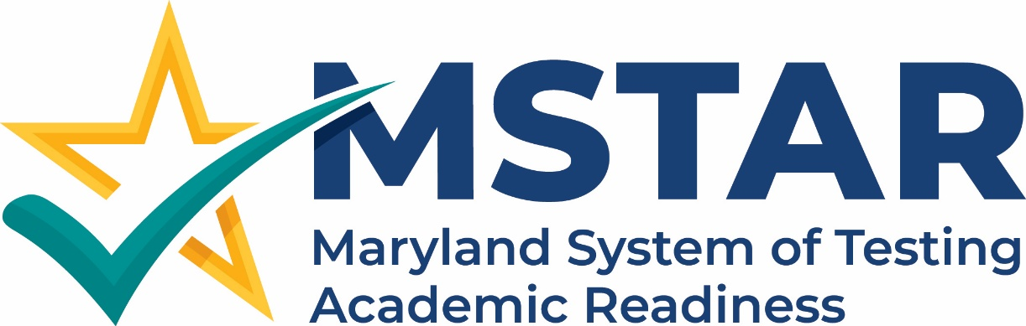
July 2026
Tech Coordinator Assessment Training
Division of Assessment and Accountability
July 15,^{th} 2026
MSDE, Pearson, Cambium Assessment
Notes:
Pearson/ MSDE

Slide 2
Day 2 – Tech Coordinator Focused
Customer Support
Notes:
Suzanne

Slide 3
Timeline Reminders
Legacy Summer 2026 admin is in ADAM / TestNAv
Starting with the Winter admin, and the assessments that will be both be administered under MSTAR's umbrella in the new system.
System definitions:
LP: LaunchPad offers a unified login experience, giving users centralized access to their assessment applications.
TIDE: Registration system used to student assignment tags and accommodations, submit reset and invalidation requests, order additional paper materials, and monitor student test progress.
TDS: The core platform that students use to take secure tests, and that teachers use to manage and monitor live exam sessions.
Notes:
Suzanne

Slide 4
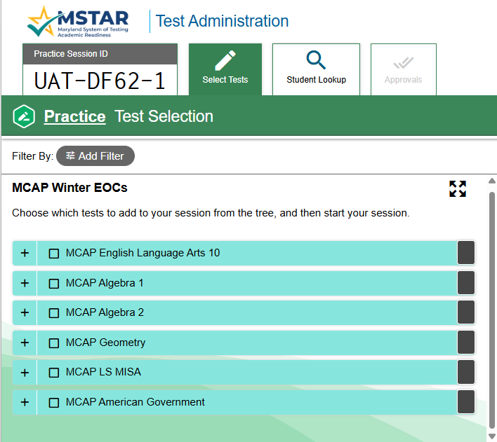
Winter 2026 Legacy Assessments, administered under the new MSTAR Program
MCAP ELA 10
MCAP Algebra 1
MCAP Algebra 2
MCAP Geometry
MCAP LS MISA
MCAP American Government
Notes:
Suzanne

Slide 5
Day 2 - Technology Readiness
Technology Readiness
TDS Secure Browser available Monday, July 20th, in the MSTAR Customer Portal
System technology readiness and requirements Technology Guide
Setting up Test Administrator (TA) Devices
Device & OS support for student testing devices
Network readiness & diagnostics
Notes:
Suzanne
- We are going to start today's session with a focus on the role of the Technology Coordinator and their support role with MSTAR testing. We are going to discuss the TDS Secure Browser and where to download it, system technology readiness and requirements, device and support for student testing devices, and network readiness and diagnostics.

Slide 6
Supported Devices and System Requirements
Technology Readiness
Make sure your devices are supported and meet the minimum hardware and software requirements.
Online testing performance can be improved by using computers with faster processors and more disk space than what is minimally required.
CAI has a robust plan for supporting operating systems during the upcoming and following years. This plan helps districts and schools manage operating system deployments based on support timelines.
Notes:
Suzanne

Slide 7
Setting up the Test Administrator Site
Technology Readiness
It is unlikely that any setup is required for your Test Administrator (TA) workstations.
Nearly any modern device, including mobile devices like tablets, with any modern browser can be used to access the TA Interface and administer a test session.
Any device you already use to check your email and access the Internet should be capable of administering tests.
TAs can print test session information or test items for students with the print-on-request accommodation.
If your school uses a firewall or other networking equipment that blocks access to public websites, you may need to add CAI websites to the allowlist.
For a list of websites to add to the allowlist, refer to the Technology Guide on the Portal.
Notes:
Suzanne

Slide 8
Accessing Other CAI Systems
Technology Readiness
Access to other CAI systems requires the use of one of the following supported web browsers:
  Chrome 148 or higher
  Firefox 148 or higher
  Edge 148 or higher
  Safari 26 or higher
For the best experience, TIDE and CRS should be accessed on desktops or laptops running Windows, macOS, or Linux.
TestNav System Requirements
Notes:
Suzanne
For each operating system listed below, the Test Delivery System (TDS) supports the latest minor version (generally, the number that appears after the decimal) released to stable channels at the start of each new school year. For example, if the minimum supported version of ChromeOS is 144, that means ChromeOS 148 is supported. Similarly, if macOS 26.0 is supported, that means macOS 26.4 is supported.
Before testing begins in your school or district, be sure to update your devices to at least the version listed on this page. During the school year, feel free to update devices as needed. CAI tests every new version released. If any issues are found in new versions, you will be notified via an announcement and the issue will be resolved as quickly as possible.

Slide 9
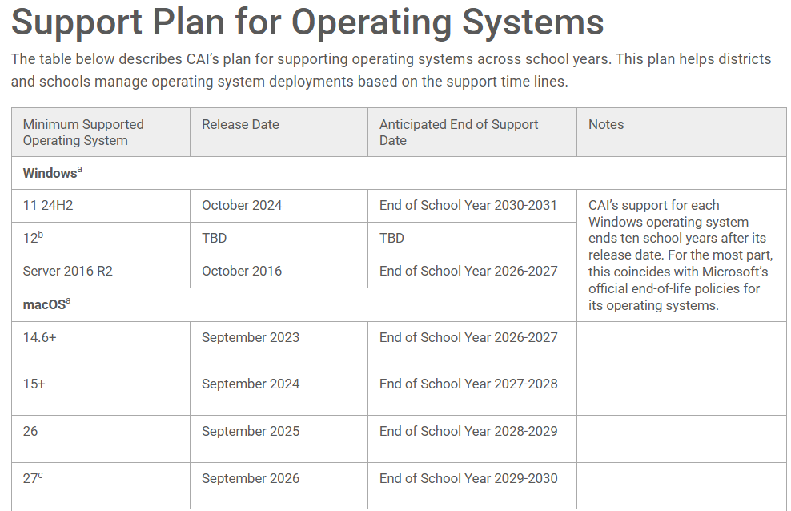
Support Plan for Operating Systems
Technology Readiness
Notes:
Suzanne
This slide provides just an example of the support plan that will be part of the Technology Readiness documentation available to support Maryland school districts.

Slide 10
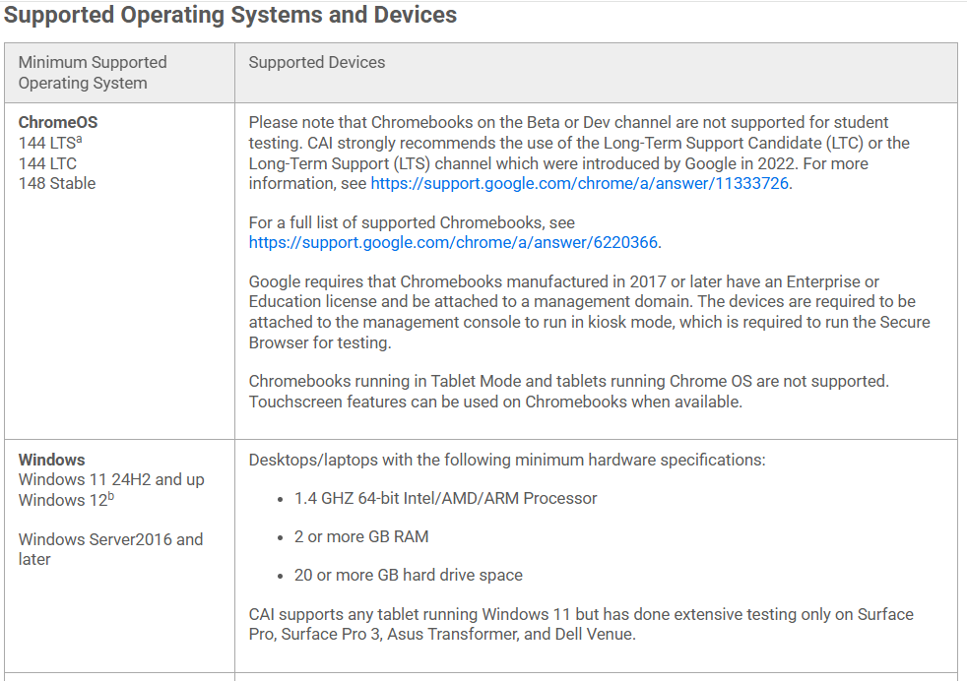
Supported Operating Systems and Devices
Technology Readiness
Notes:
Suzanne
This slide provides just an example of the supported operating and devices that is part of the Technology Readiness documentation available to support Maryland school districts.

Slide 11
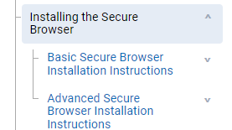
Installing the Secure Browser
Technology Readiness
If you manage a large number of machines across your school or district, you can likely use the same tools with which you are already familiar to push the Secure Browser out to all of your machines at scale.
If you manage the technology at a small school, you can follow the basic installation instructions on the portal to install the Secure Browser.
The Secure Browser is installed the same way as most other software.
Notes:
Suzanne
If you are a Technology Coordinator and it is your responsibility to manage a large number of machines across your school or district, you can likely use the same tools with which you are already familiar to push the Secure Browser out to all of your machines at scale.
If you manage the technology at a small school, you can follow the basic installation instructions on your portal to install the Secure Browser. The Secure Browser is installed the same way as most other software. You will be asked to download a file, open that file, and follow prompts to install the Secure Browser. If you are familiar with installing software, install the Secure Browser the same way.

Slide 12
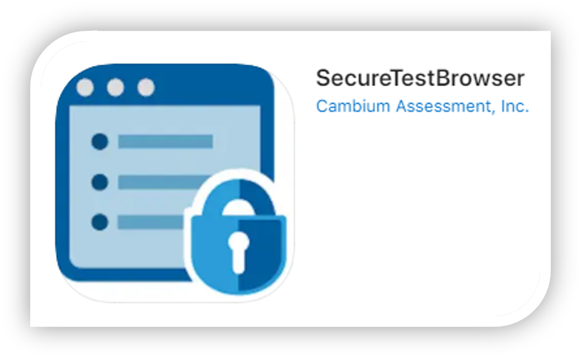
Installing the Mobile Secure Browser
Technology Readiness
The SecureTestBrowser app for iPads and the SecureTest app for Chromebooks are CAI’s mobile versions of the CAI Secure Browser.
The apps are available in each app store to download and install.
The first time you open the app, it will ask you to choose your state and assessment program. Your choice will be saved, and the mobile Secure Browser will perform like the desktop version, allowing you to access operational tests, practice tests, and the network diagnostic tool.
You can also use any mobile device management utility to install the Secure Browser on multiple managed devices and configure those devices.
Notes:
Suzanne
The SecureBrowser app for iPads and the SecureTest app for Chromebooks are CAI’s mobile versions of the Secure Browser. The apps are available in each app store to download and install.
The first time you open the app, it will ask you to choose your state and assessment program. Your choice will be saved, and the mobile Secure Browser will perform like the desktop version, allowing you to access operational tests, practice tests, and the network diagnostic tool. You can also use any mobile device management utility to install the Secure Browser on multiple managed devices and configure those devices.

Slide 13
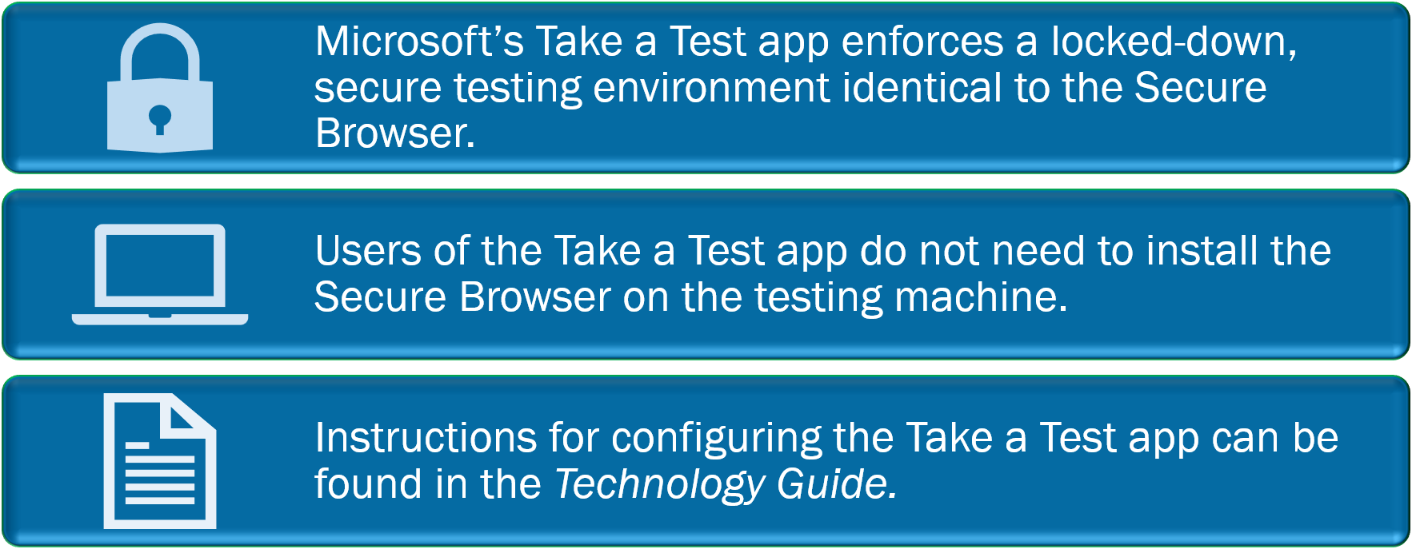
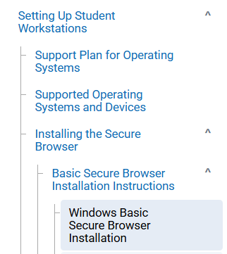
Microsoft's Take a Test App
Technology Readiness​
Notes:
Suzanne

Slide 14
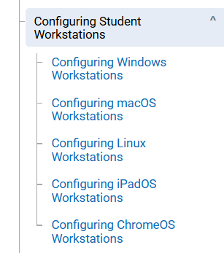
Configuring Student Workstations
Technology Readiness​
For devices running Windows, macOS, Linux, or ChromeOS, a few additional configurations are needed before secure testing can begin.
Some operating systems have features that can compromise a test’s integrity.
Completing these additional configurations will prevent security breaches.
For a detailed list of additional configurations required for Windows, macOS, Linux, iPadOS, and ChromeOS, see the “Configuring Student Workstations” section of the Technology Guide.
Notes:
Suzanne

Slide 15

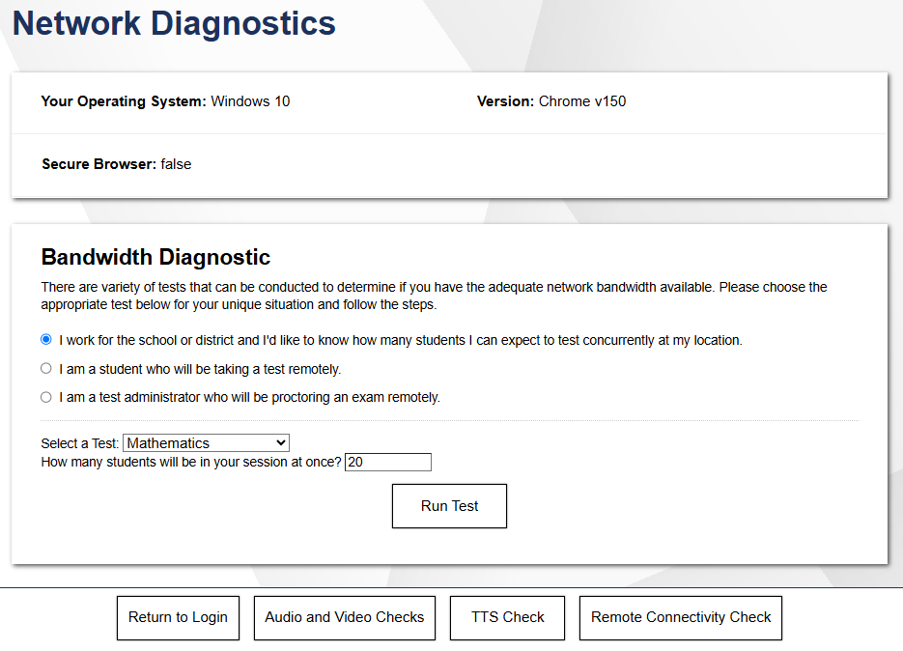
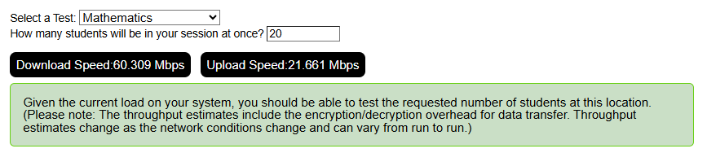
Network Readiness and Diagnostics
Technology Readiness
Notes:
Suzanne
Technology Coordinators and other users can select the test they are going to administer, the number of students they would like to test at one time, and select ‘Run Network Diagnostics Tests’ to test system bandwidth. This allows any bandwidth issues to be identified in advance of testing to ensure a smooth testing experience for students.

Slide 16
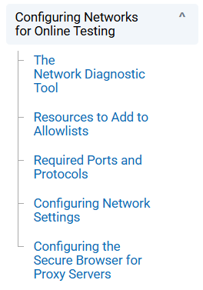
Resources to Add to Allowlists
Technology Readiness​
CAI provides certain URLs that may be blocked by your network’s firewalls. These URLs must be added to your allowlists prior to testing.
A detailed list of these URLs can be found in the “Resources to Add to Allowlists” section of the Technology Guide.
If your testing network includes devices that perform traffic shaping, packet prioritization, or Quality of Service, ensure that these URLs have high priority.
Notes:
Suzanne

Slide 17
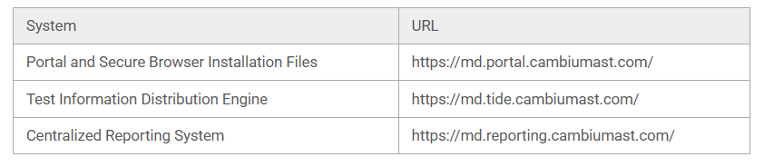
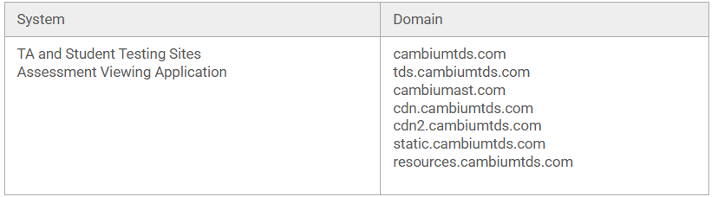
URLs to Add to Your Allowlist
Technology Readiness​
Notes:
Suzanne

Slide 18
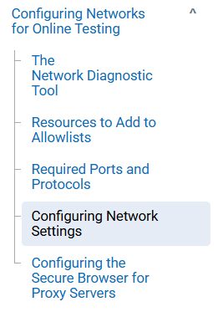
Configuring Network Settings
Technology Readiness​
Local area network (LAN) settings on testing devices should be set to automatically detect network settings.
Detailed instructions on configuring network settings for devices running Windows and macOS can be found in the “Configuring Network Settings” section of the Technology Guide.
Notes:
Suzanne
The Secure Browser automatically attempts to detect settings for your network’s web proxy server. However, use of web proxies should execute a proxy command once from the command prompt. This command does not need to be added to the Secure Browser shortcut. See the “Configuring the Secure Browser for Proxy Servers” section of the Technology Guide for tables listing the form of the command for different settings and operating systems.

Slide 19
Configuring Assistive Technologies
Technology Readiness​
Embedded Support Features | Description
Embedded Text-to-Speech (TTS) | Using TTS requires at least one voice pack to be installed on the student workstation. Windows, Mac, iPadOS: Voice packs that ship with the operating systems out of the box are fully compatible with the Secure Browser. Chrome: Voice packs that ship out of the box for Chrome OS devices, but the pause feature does not work properly on these devices. Linux: Linux Secure Browser installation package contains English- and Spanish-language voice packs.
Embedded Speech-to-Text (STT) | TDS offers an embedded STT solution. This embedded tool is supported on Windows, Mac, Linux, iPadOS, and Chrome OS.
Embedded Word Prediction | TDS offers an embedded word prediction feature on all supported operating system
Notes:
Suzanne
List of assistive technologies embedded in TDS. If a Chromebook is being used, there is a workaround that allows students to highlight a passage of text and have TTS read just that passage, eliminating the need for the pause feature.

Slide 20
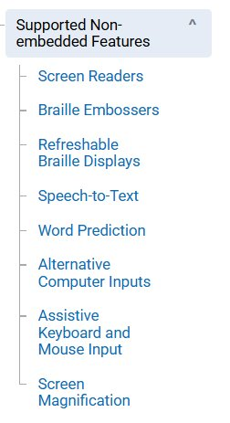
Non-Embedded Assistive Technology & Permissive Mode
Technology Readiness​
Requires the use of other hardware and/or software to make certain functionality available to students within TDS.
Non-embedded features require settings be set to Permissive Mode.
Permissive Mode is found in TIDE as a student test setting, temporarily lowers the security settings of the Secure Browser so that the student can interoperate with other software on the device, like JAWS or ZoomText, while they are taking the test.
Permissive Mode is supported on Windows and macOS.
Notes:
Suzanne
An assistive technology manual will be available on the Portal later this summer.

Slide 21
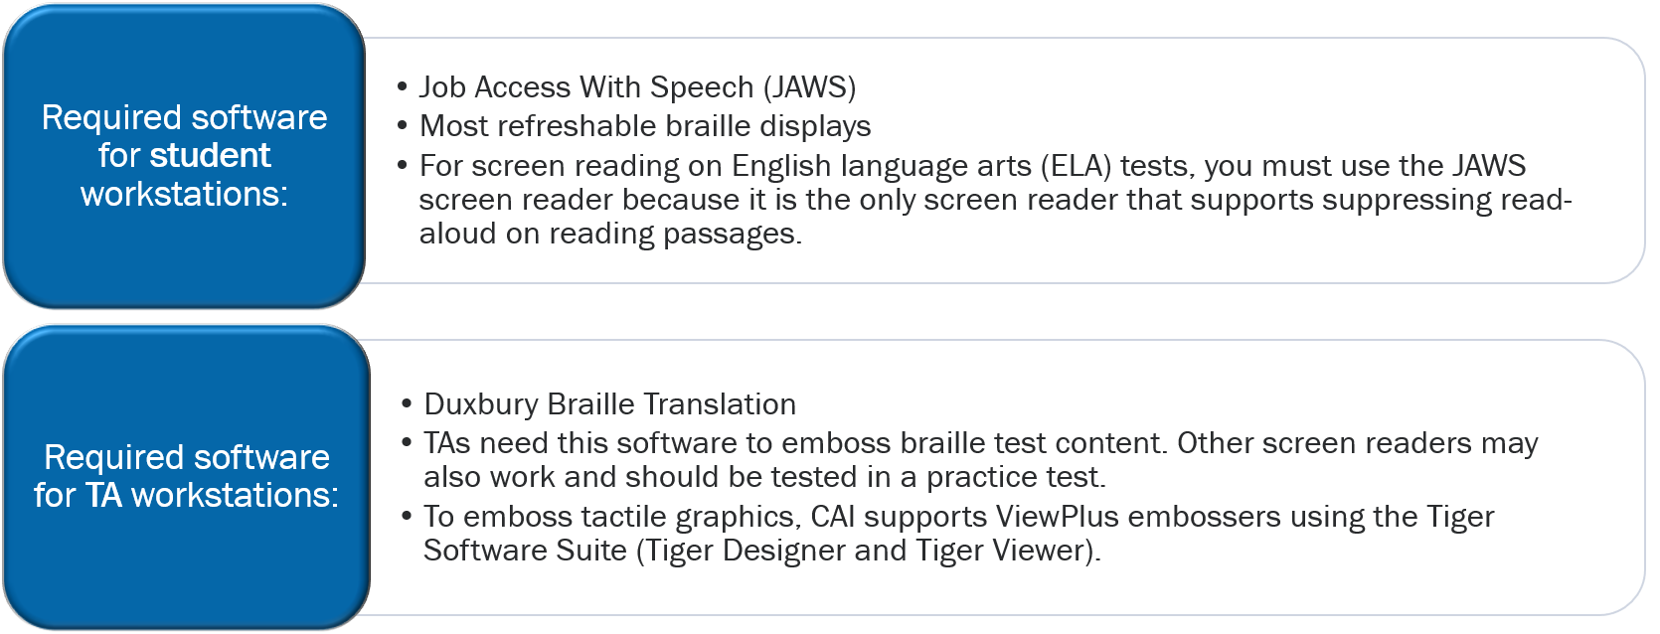
Screen Readers
Technology Readiness​
Screen readers allow students to read text displayed on a screen with a speech synthesizer or braille display.
Notes:
Suzanne
Screen readers allow students to read text displayed on a screen with a speech synthesizer or braille display. The student’s workstation must have software installed to access screen readers during online testing.
CAI supports Job Access With Speech (JAWS) for student workstations. TA workstations must have Duxbury Braille Translation software installed. TAs need this software to emboss braille test content. Other screen readers may also work and should be tested in a practice test. For instructions on how to configure screen readers, see the Assistive Technology Manual.

Slide 22
Mini Practice Test Working Session
Notes:
Suzanne

Slide 23
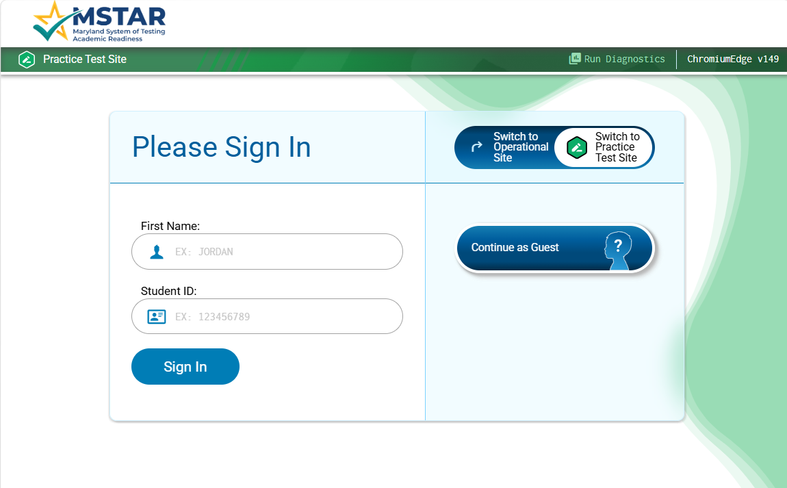
Working Session: Mini Practice Test
Notes:
Suzanne - https://mdpt.cambiumtds.com/student

